Slide 1
Rural Maryland Council
Feeding Our Future
March 20, 2026

Slide 2
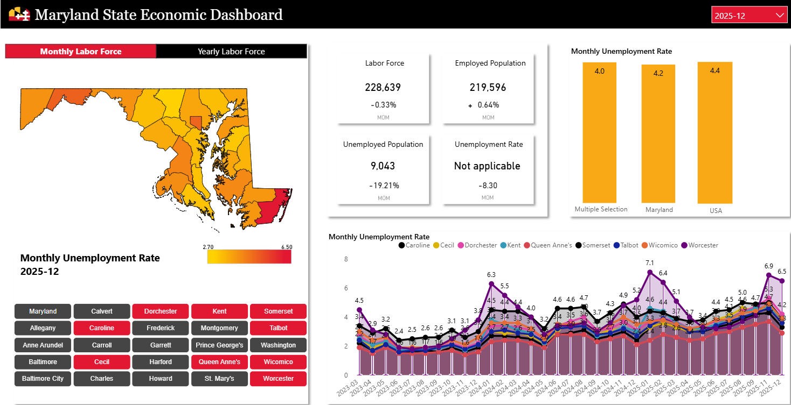

Slide 3
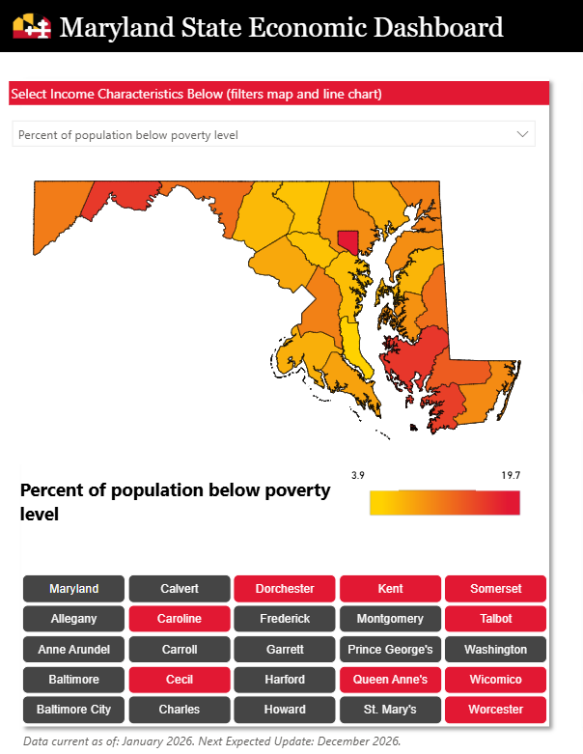

Slide 4
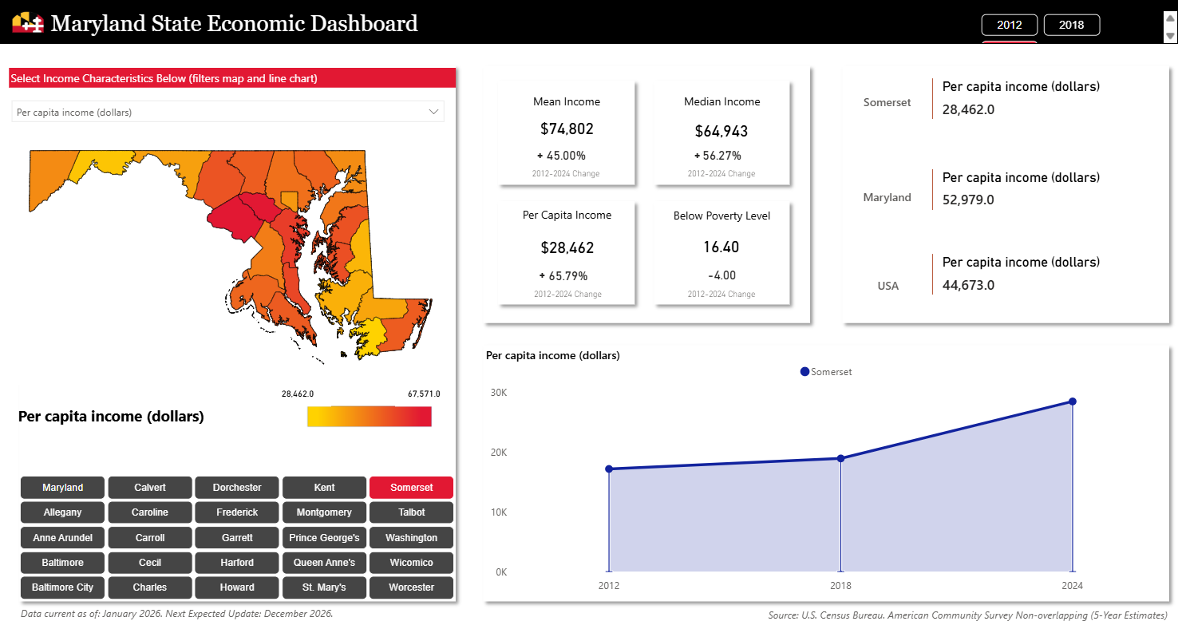

Slide 5
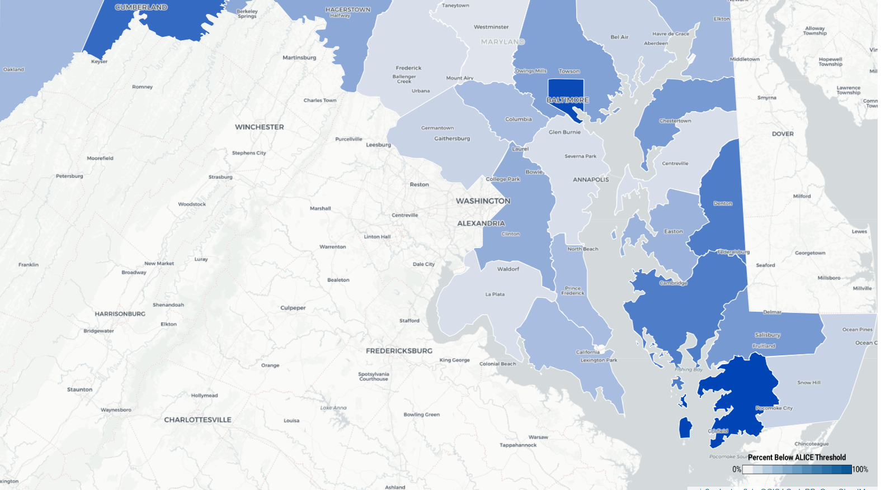

Slide 6
RMC Grant Programs
Maryland Agricultural and Rural Development Assistance Fund
Capacity building grants for rural serving nonprofits
Have funded food distribution and agriculture education
Last year distributed 24 grants for a total $670,126
Rural Maryland Prosperity Investment Fund
Focused on Entrepreneurship, Infrastructure, Health and Regional Economic Development
Last year distributed 33 grants for a total $2,873,359

Slide 7
RMC’s participation in RHTP
Increase Local Healthy Food Access: Aggregation
RHTP funds will cover the start-up costs for food aggregation systems.
In addition to food aggregators, RHTP funds will help offset food safety equipment.
Funded through competitive RFPs through MAERDAF/RMPIF Grant Review Board
  Spur Maryland institutions to purchase locally grown food
  Funds will cover the start-up costs of pivoting away from traditional food purchasing systems to focus on locally produced foods.
  Provide resources to food purchasers to plan for and implement processes to purchase local, healthy foods on an ongoing basis, ultimately increasing the volume and value of local food sold.

Slide 8
  Monday, April 20 - Grant Portal Opens
  Tuesday, April 22 - Grant Info Session Webinar
  Thursday, April 24 - Grant Info Session – Location TBD
  Tuesday, April 29 - Grant Info Session – Location TBD
  Thursday, May 1 - Grant Info Session – Location TBD
  Friday, May 15 - Letter of Intent (LOI) Deadline MAERDAF/RMPIF/RHTP Application
  Wednesday, June 3 - Grant Review Board, Phase 1
  June 8–12 - Phase 1 MAERDAF/RMPIF Decision Notifications (Grantees notified)/Full RHTP Decisions
  Friday, July 10 – MAERDAF/RMPIF Full Applications Due
  August 17–21 - Awards Announced
Important Dates
FY2027

Slide 9
Thank you
Charlotte Davis
charlotte.davis@maryland.gov
(410) 841-5774
Rural.Maryland.gov

