Slide 1
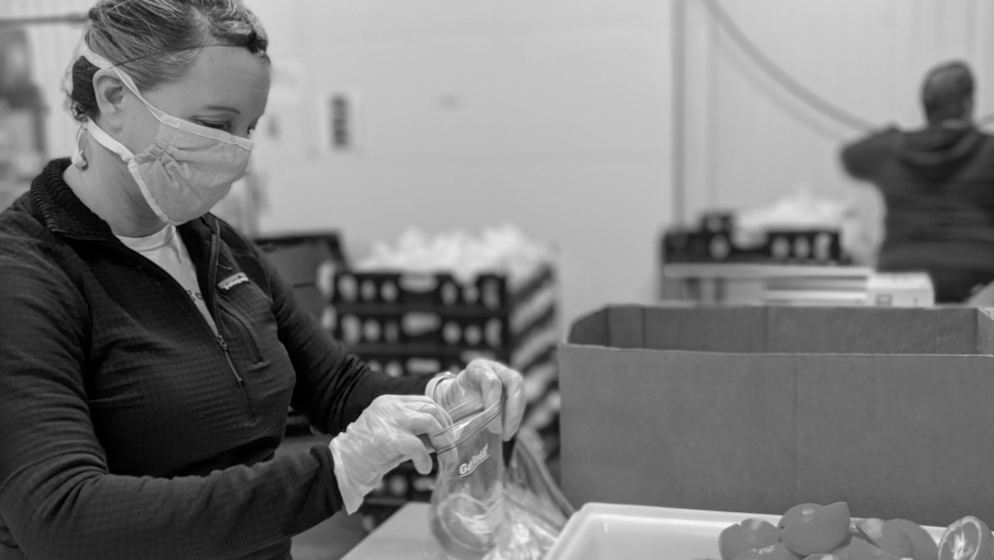

Maryland Food Insecurity:
Impact Upon Rural Communities

Slide 2






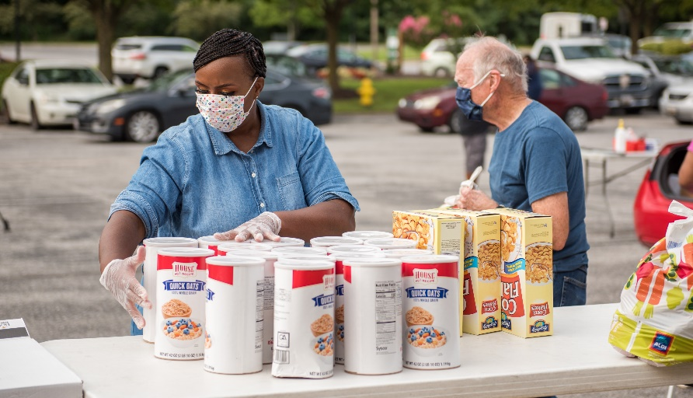













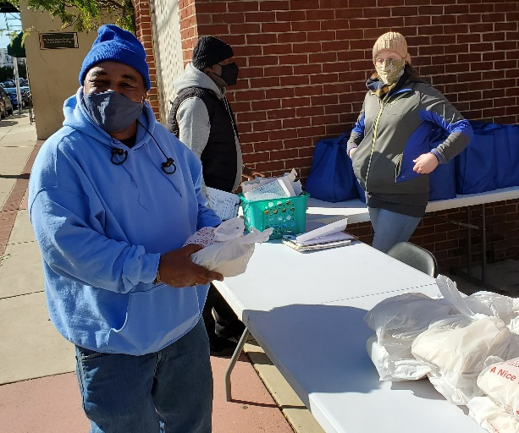
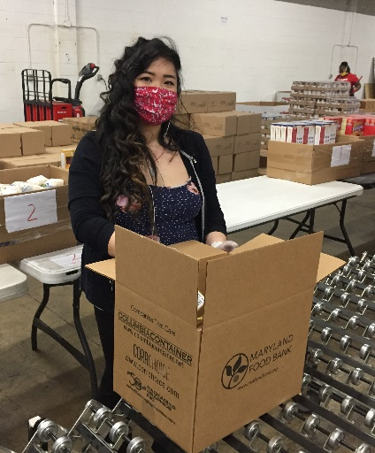
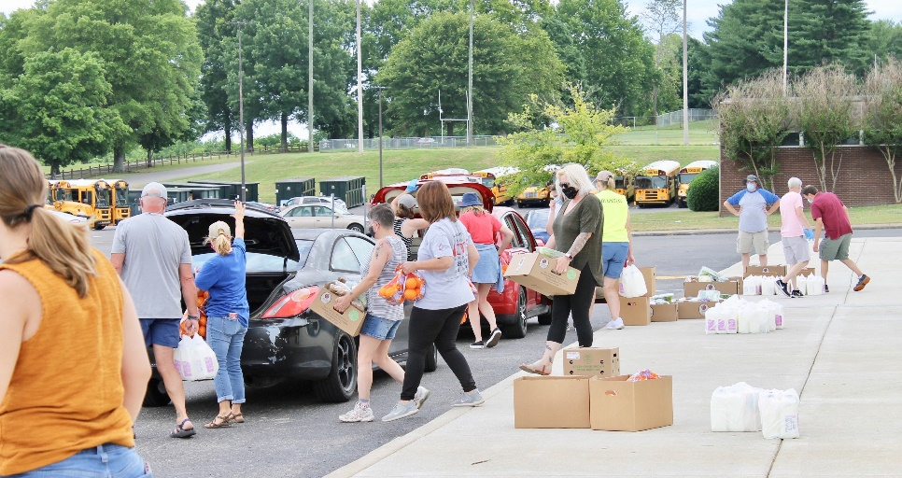
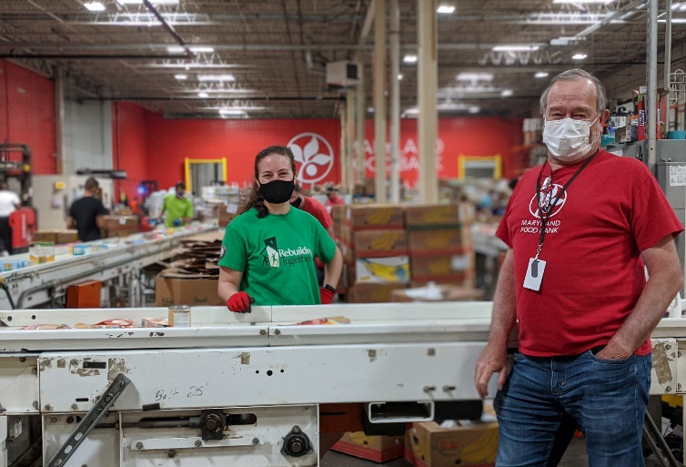
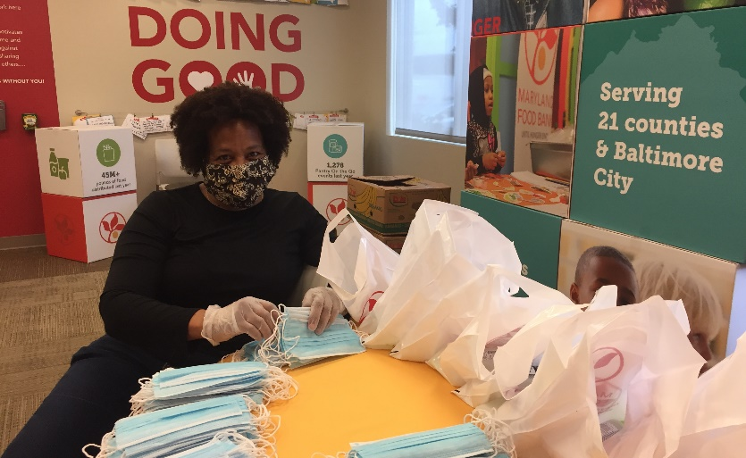
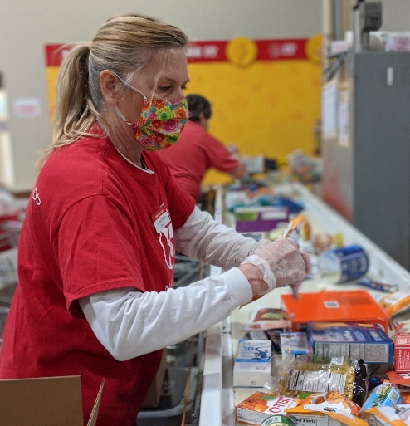
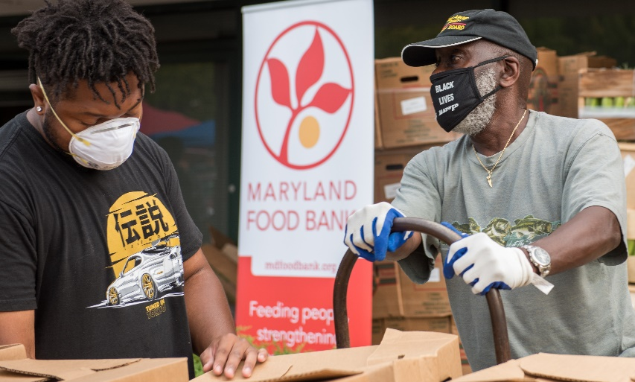
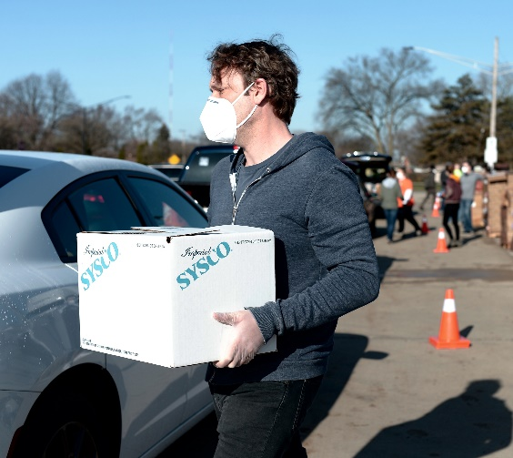

Slide 3
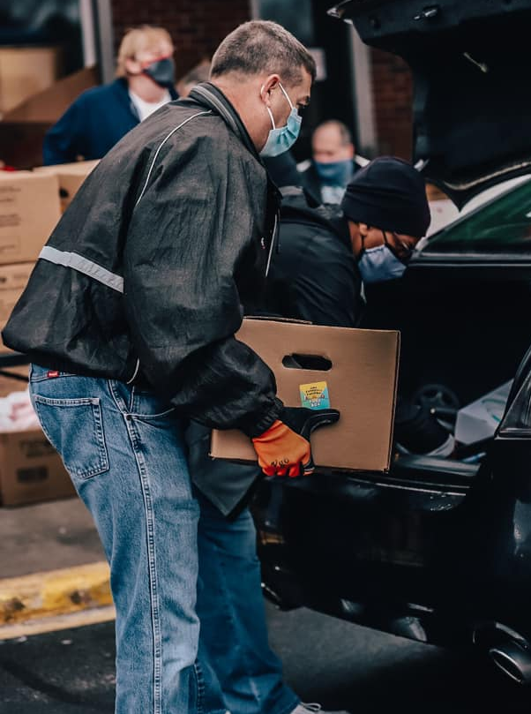
“I cannot adequately express how much the Maryland Food Bank has helped. The need has increased in our community, and we would not have been able to sustain a weekly opening, and deliveries, if MFB wasn’t willing to continue delivering to us even though schools were closed throughout the summer.”
Administrator, Pocomoke Elementary School
Pocomoke City, MD
“The company I worked for closed last year, and while I have been able to find part-time work, it’s not enough to cover my rent, my bills, and be able to get food at the grocery store. I honestly don’t know how my daughter and I would get by…”
Anne, food pantry recipient
Under-employed Mother

Slide 4
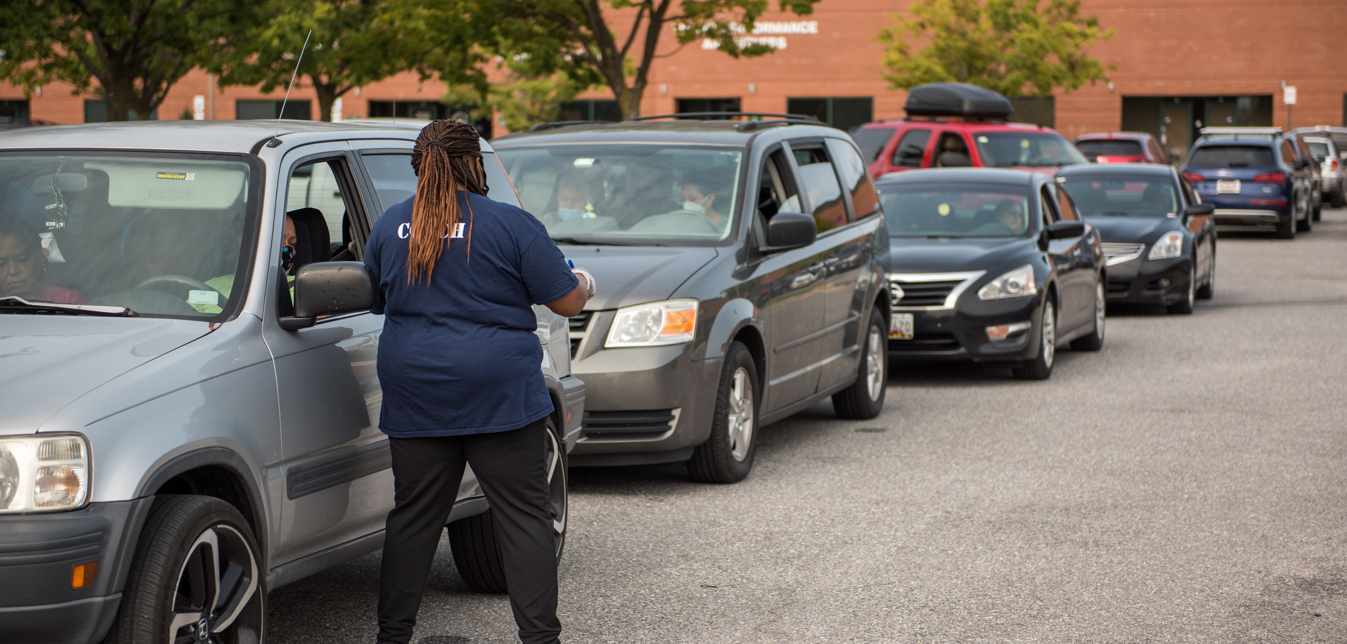
MFB’s COVID-19 RESPONSE
MARCH 2020 – JUNE 2021
MFB DISTRIBUTED ENOUGH FOOD TO PROVIDE
66,000,000
meals to Marylanders
MFB held
MFB distributed Over
MFB distributed Nearly
MFB spent
MFB distributed Over
MFB held Over
$36M
714,000
4,100
449,000
80M
on food
Grab & Go meals
to school children
Pantry on the Go events
Back Up Boxes
pounds of food
418%
88%
increase over prior year
increase over prior year

Slide 5
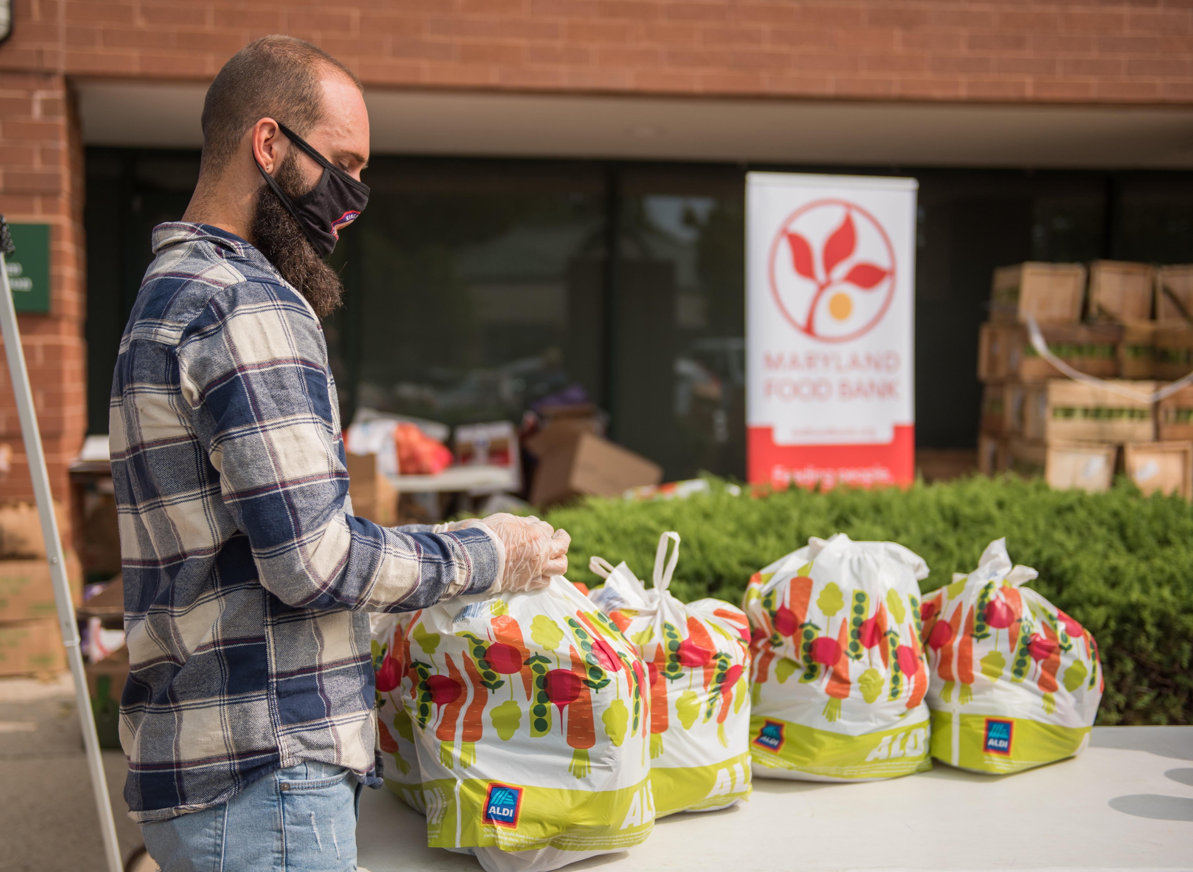
MFB EASTERN SHORE
COVID-19 RESPONSE
MARCH 2020 – JUNE 2021
MFB EASTERN SHORE DISTRIBUTED ENOUGH FOOD TO PROVIDE
10,800,000
meals to Marylanders
MFB held
MFB distributed Over
MFB distributed Over
MFB held
MFB distributed Over
1.6M
405
4,300
13M
Pounds of food
through School Pantry programming
Pantry on the Go events
Back Up Boxes
pounds of food
30%
increase over prior year

Slide 6
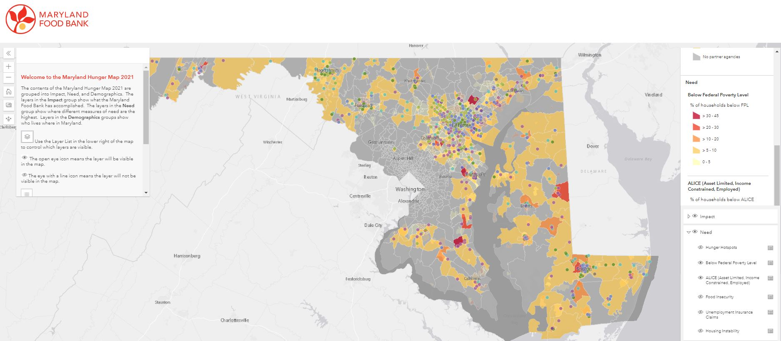
Looking Ahead: Food Insecurity in Maryland
MFB ESTIMATES THAT
2M
Marylanders may face food insecurity in the coming year
*Current estimate from MFB and Feeding America for 2021

Slide 7
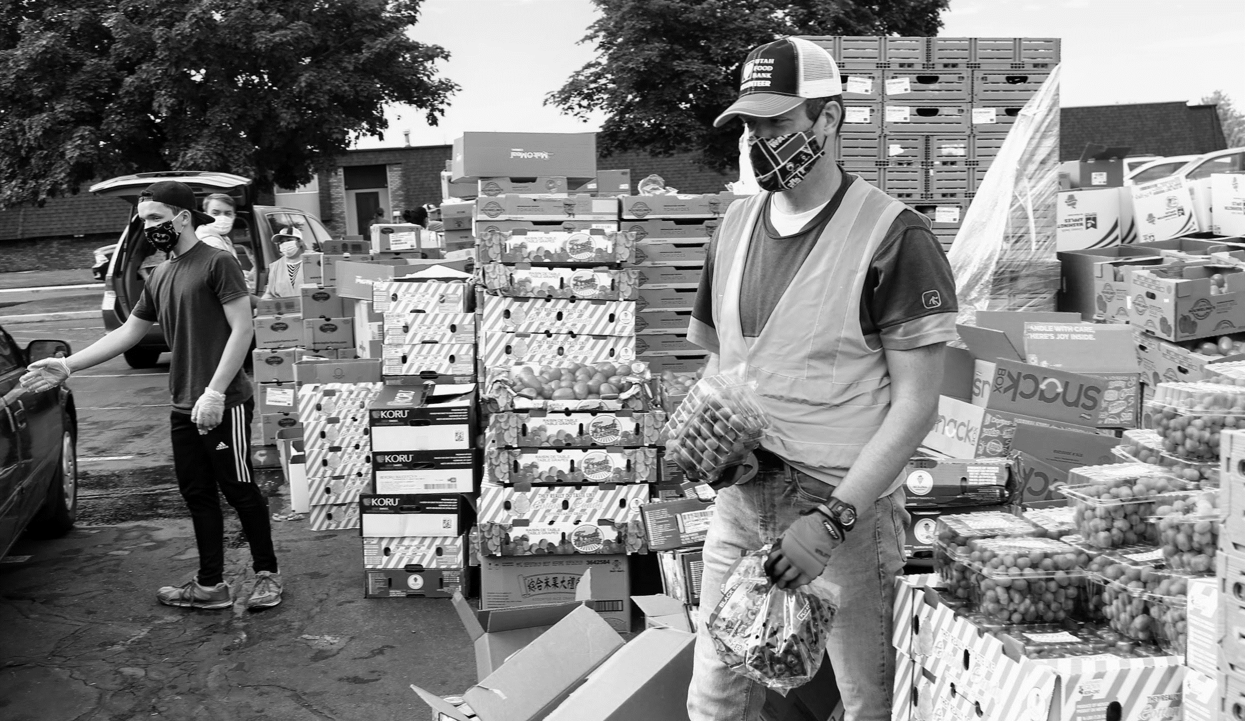
Fueling Maryland’s Recovery
MFB’s COVID-19 Response Plan

Slide 8
Doing More to Reach Targeted Populations
MFB’s statewide network of food distribution partners was adept at reaching Marylanders
in need before the pandemic hit
Since March 2020, Emergency Operations teams statewide turned to the Maryland Food Bank to provide safe, reliable, targeted food assistance to Marylanders struggling to put food on the table. Together, we were very successful at feeding Maryland
Today, we are also working intentionally to reach those most impacted by the pandemic: people of color, the homebound including older adults, and the newly unemployed
  Expanded program solutions include capacity grants, home delivery, Mobile Markets, produce boxes, and Back Up Boxes*
  Core to all MFB’s efforts is to reach people safely and in ways that preserve dignity and reduce the stigma that can be associated with receiving food assistance
Back Up Boxes are 15- or 30-pound boxes of healthy, shelf stable food designed to meet different dietary needs and preferences.

Slide 9
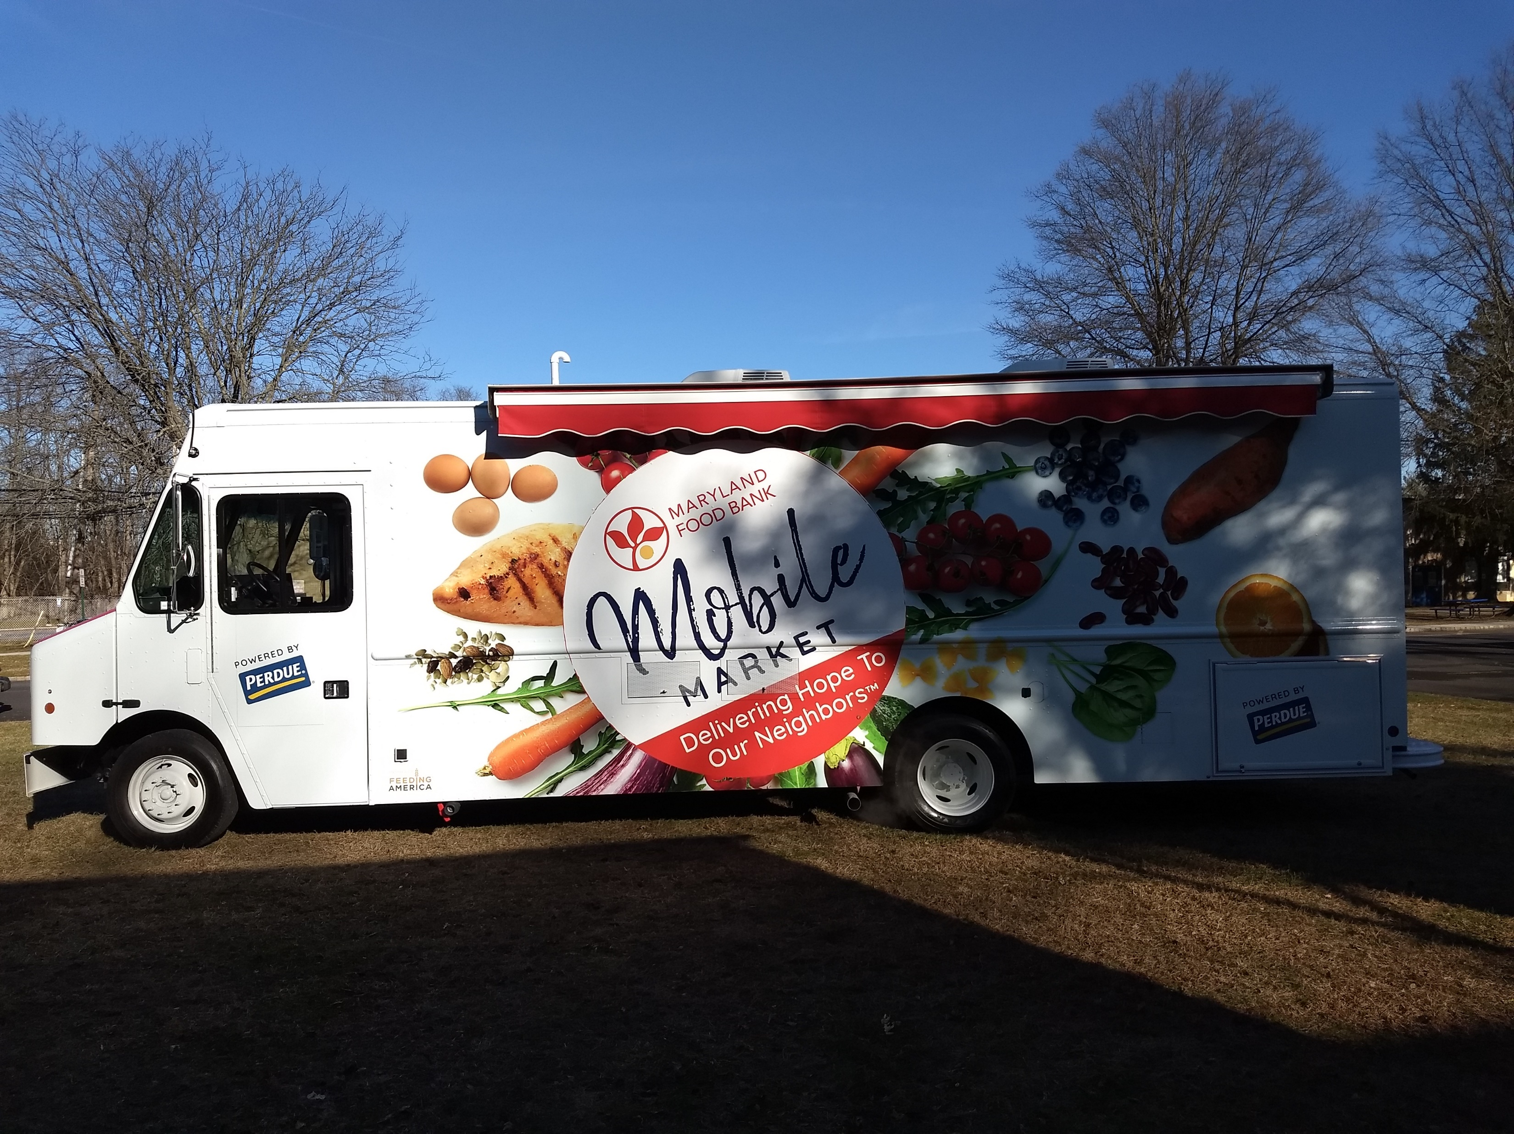
MFB’s Mobile Market
Targeting regionally defined barriers, MFB’s Mobile Market supports the wide-ranging needs of under- and unserved communities in a holistic, supportive way:
  Improving client access
  Addressing geographic challenges and
  meeting community-level priorities
  Serving as Maryland’s food-assistance
  safety net with emphasis on healthy food:
  Offer nutritious produce, meat and
  food items along with nutrition
  education at zero cost to neighbors
  Addressing regionally defined root causes of food insecurity by partnering with local health, education & social service agencies

Slide 10
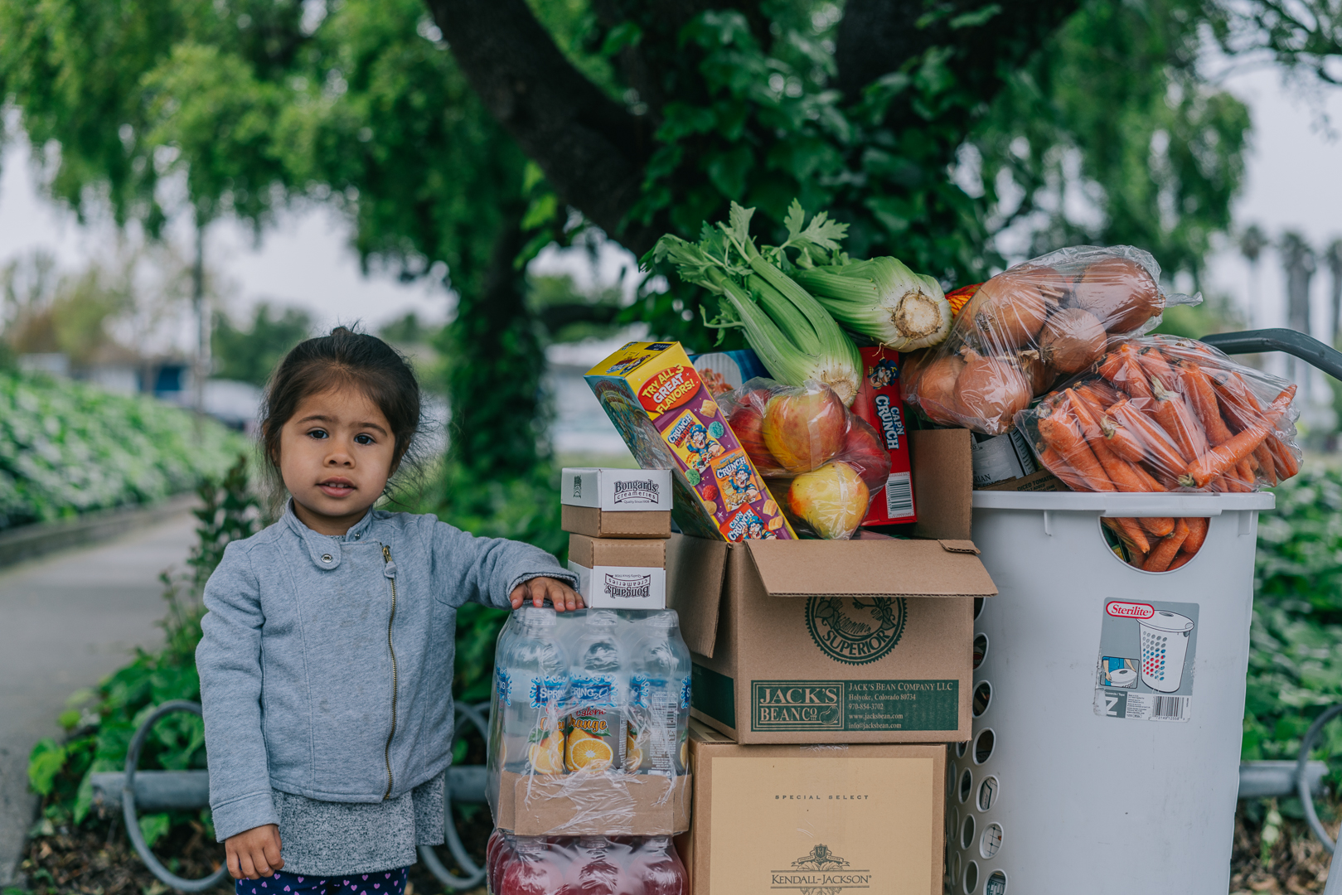
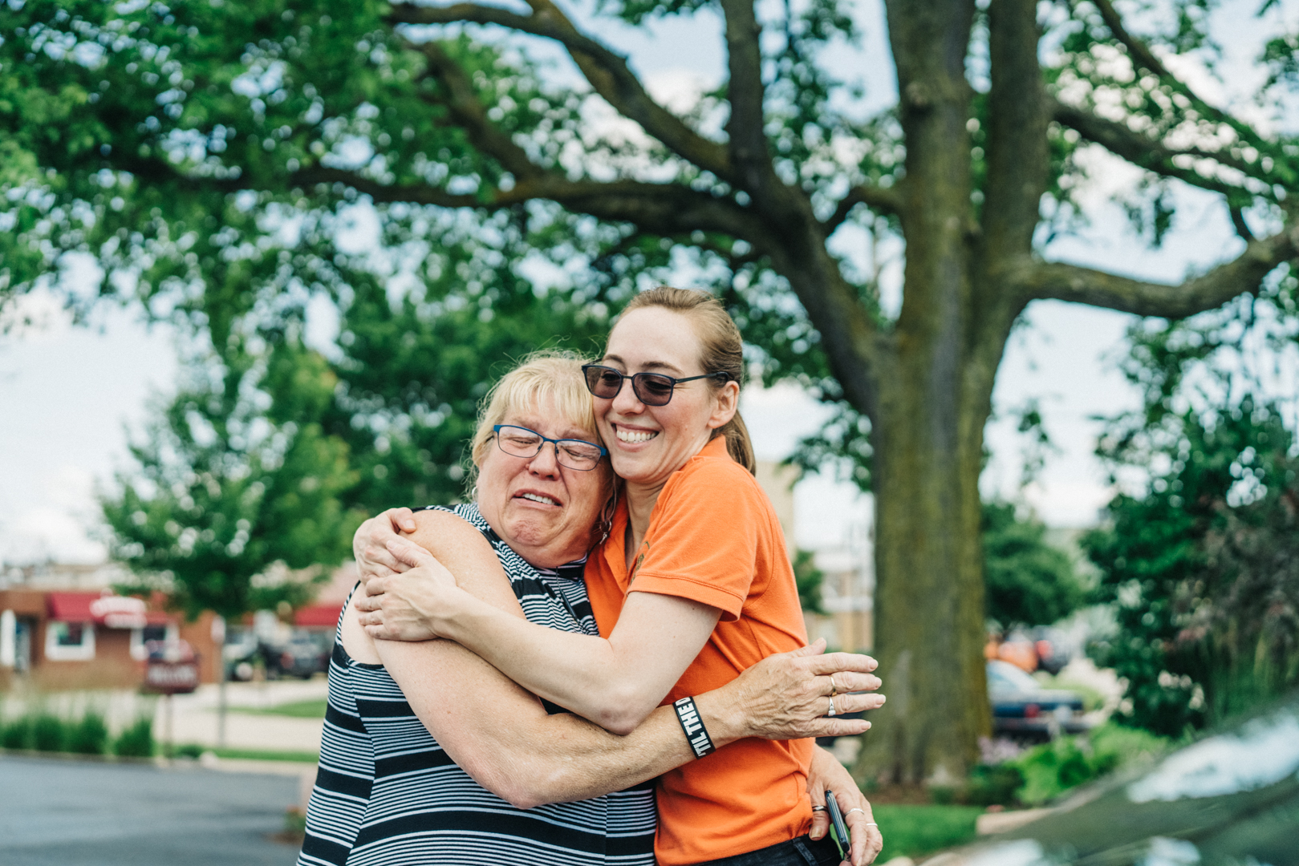
Lower Shore Vulnerable Populations Task Force
Task Force was created to respond to barriers faced by Wicomico, Somerset, and Worcester County vulnerable populations during the COVID-19 pandemic:
  Haitian Community
  Hispanic/Latinx Community
  People with disabilities
  Senior Citizens
  Low-income individuals and families
  Homeless and housing-insecure individuals
  Communities of Color
Community groups & stakeholders work collaboratively to address long-term systemic challenges contributing to the disproportionate impact of crisis situations:
  Food Access & Distribution
  Housing
  Education
  Childcare
  Information Sharing
  Masks, Supplies/PPE & COVID Vaccinations

Slide 11
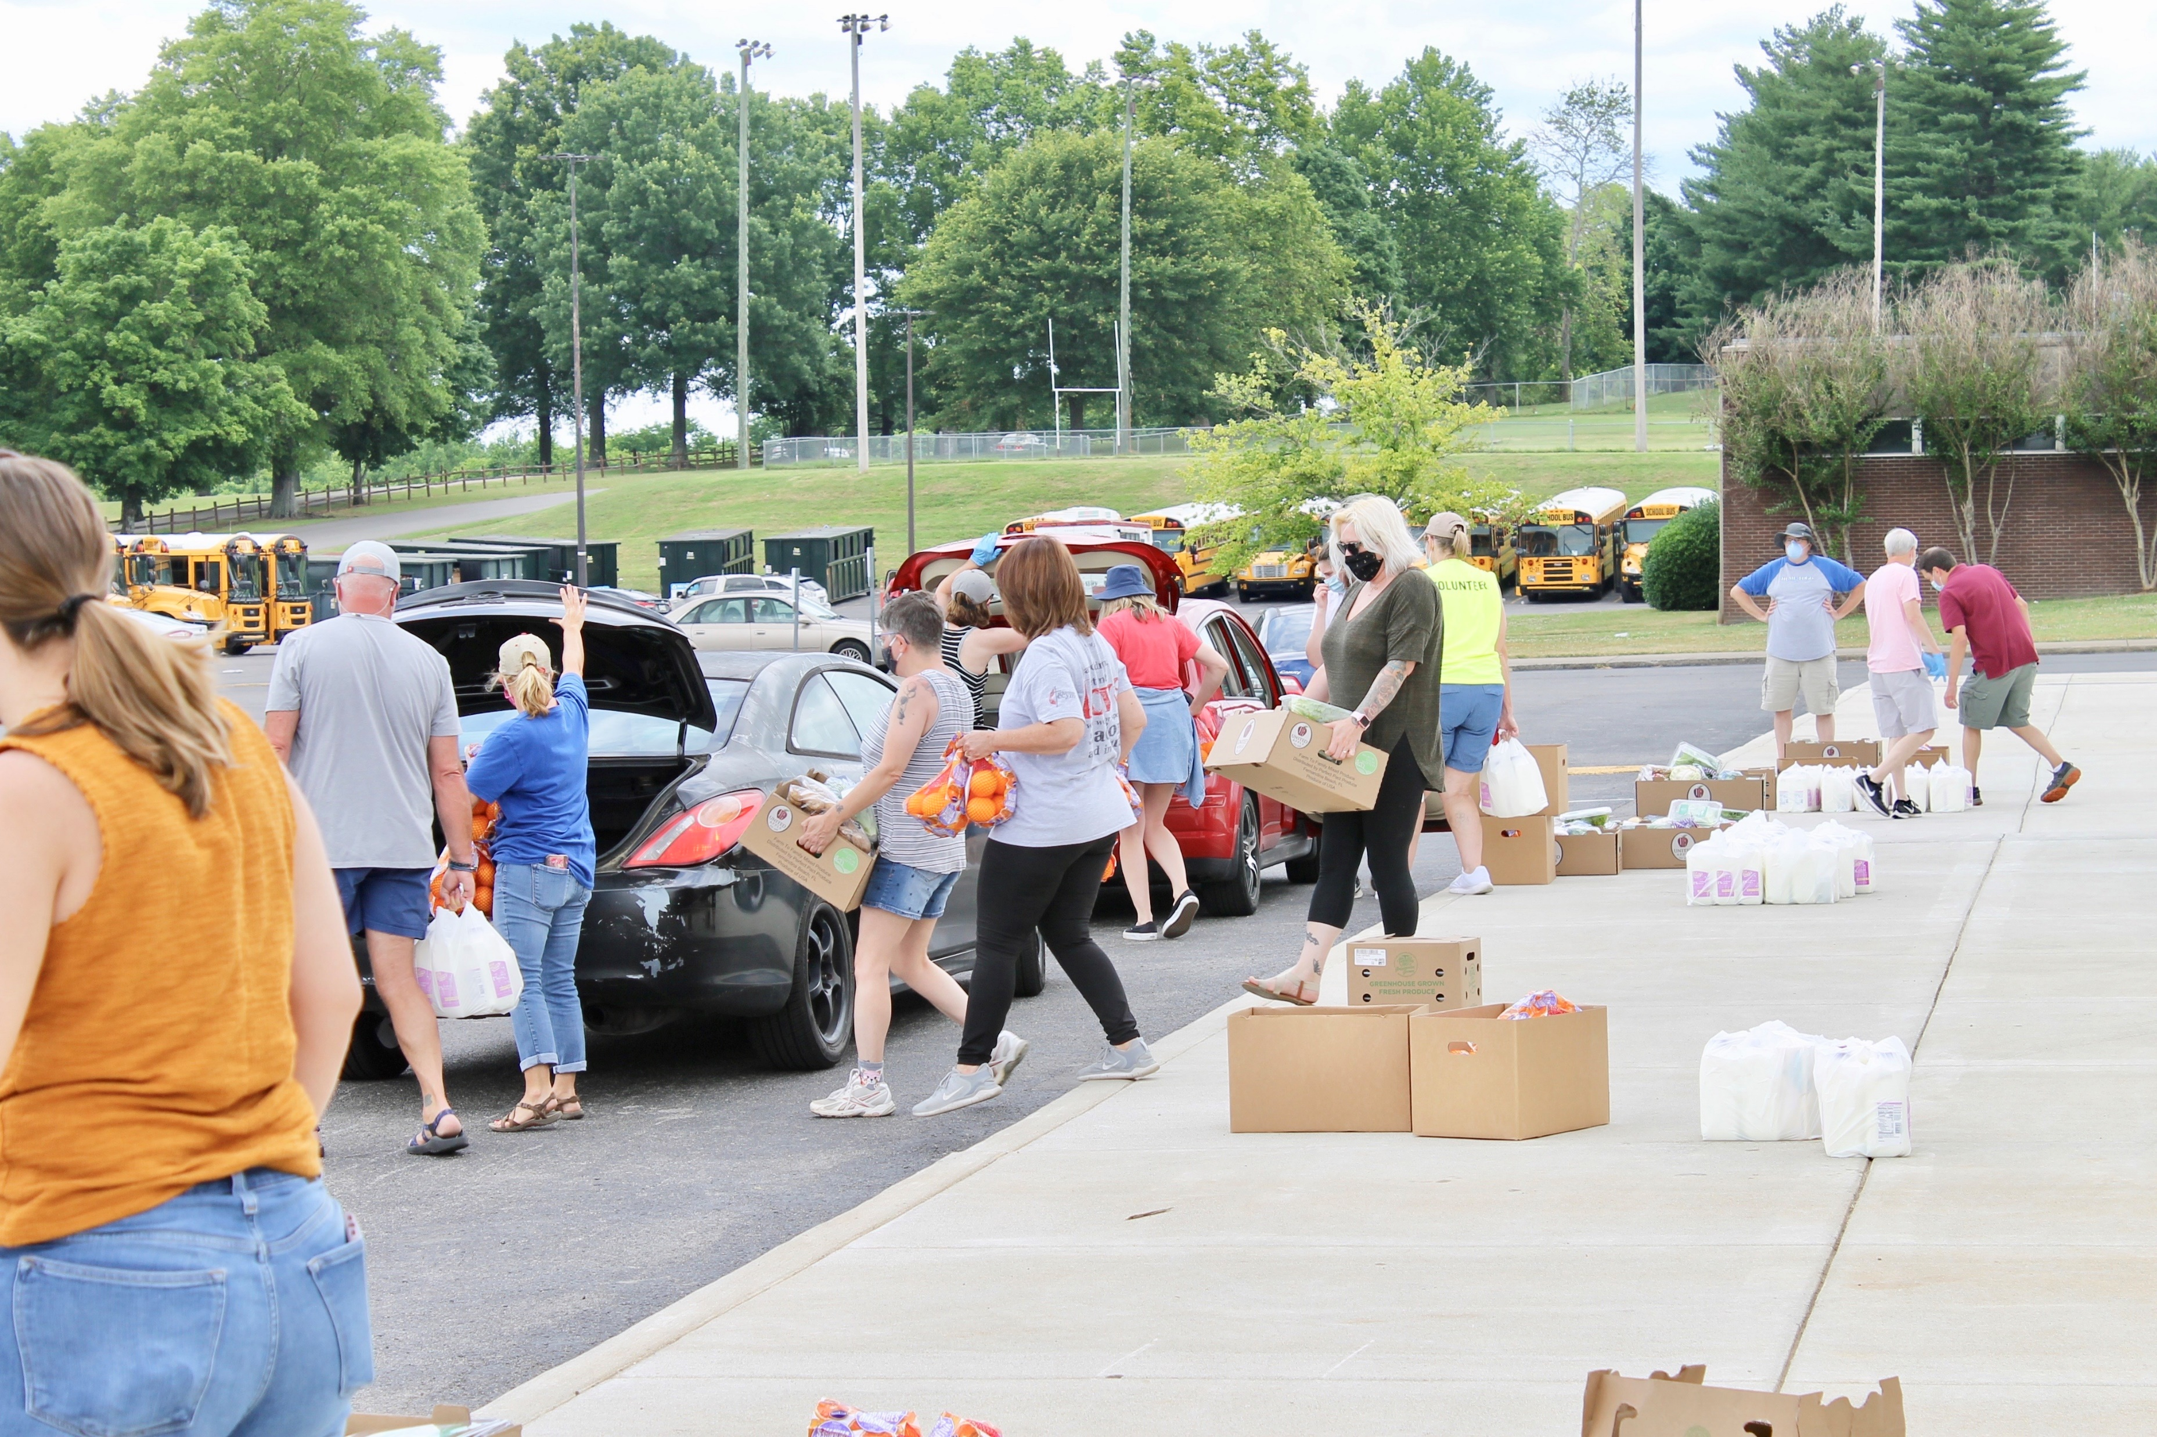

Moving MFB Strategy Forward:
Pathways out of Hunger

Slide 12
It Will Take More than Food to End Hunger
  Food insecurity is an urgent public health crisis that worsened as a result of the COVID-19 pandemic. Our future focus includes feeding people and addressing the root causes of hunger:
  Center more of our food distribution programs on those most impacted by the pandemic, including newly unemployed Marylanders, communities of color, and homebound older adults
  Distribute healthy foods along with nutrition education materials to improve health outcomes for food-insecure Marylanders
  Expand the capabilities of our network to distribute produce and proteins through capacity granting
  Fund new, innovative startup activities in underserved areas of high need
  Support job-readiness by helping Marylanders become financially stable through workforce development and training programs, including FoodWorks (FoodWorks Culinary Program-1st Class with Wor-Wic Graduates May 26th)
  Transition to a case management practice that can be integrated in the field and deployed as solutions to identified root causes of hunger
  Collect and analyze data to evaluate our impact and align MFB activities with improved outcomes for clients

Slide 13
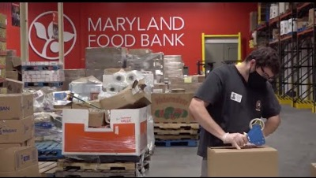

Slide 14


Slide 15


Follow-up questions can be directed to:
Jennifer Small, Senior Regional Program Director Maryland Food Bank Eastern Shore
Email: small@mdfoodbank.org

