Slide 1
Creating a Mobile Summer Meals & Community Food Access Operation

Slide 2

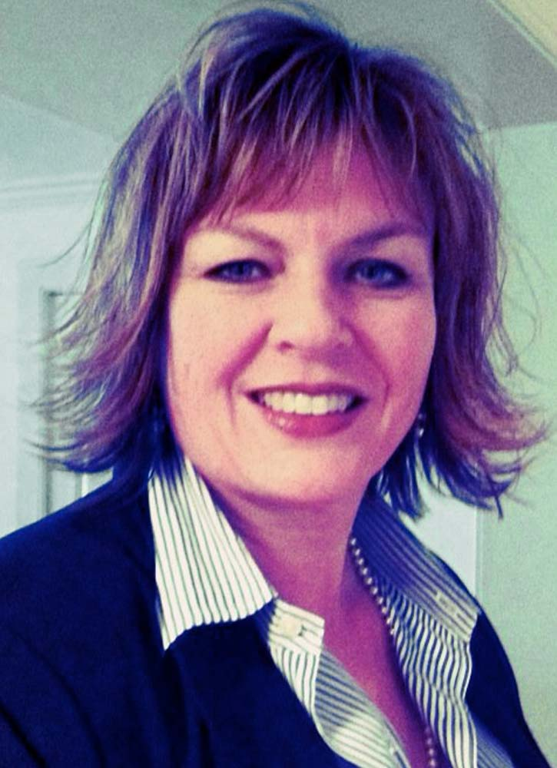

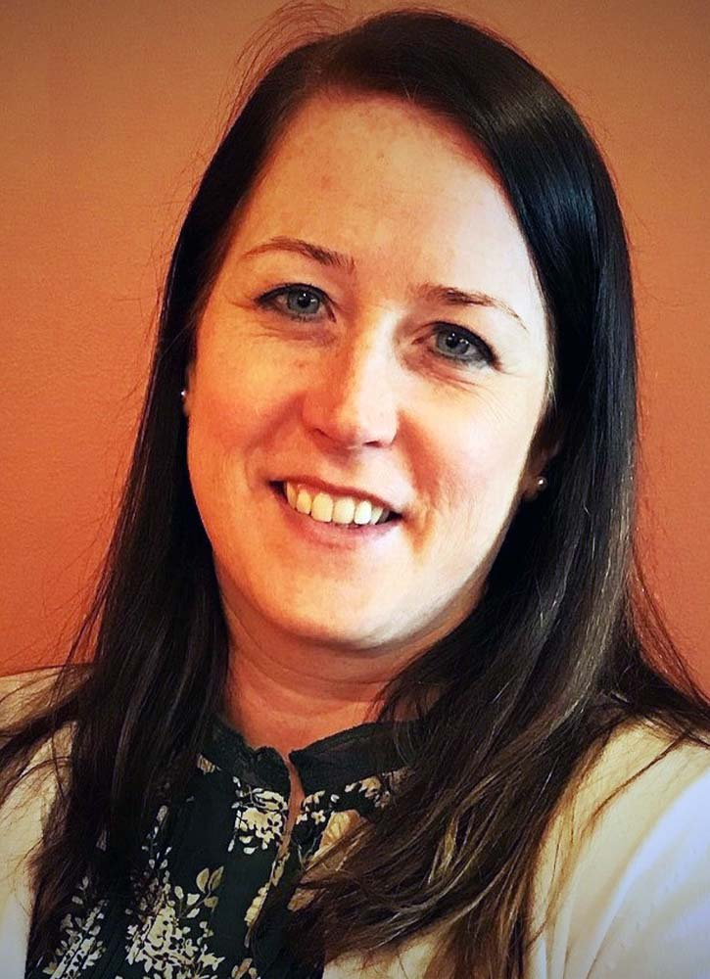

Beth Brewster
Supervisor of Food Services
Caroline County Public Schools, Maryland
Kara Panowitz, MSW
Senior Manager
No Kid Hungry MD

Slide 3

Chesapeake
FOOD CONNECTION
Goes Mobile!

Slide 4
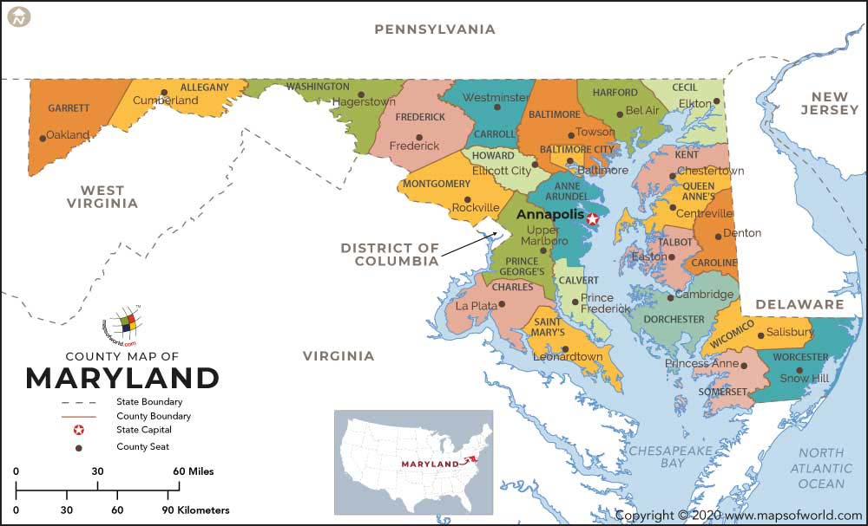
Caroline County, Eastern Shore

Slide 5
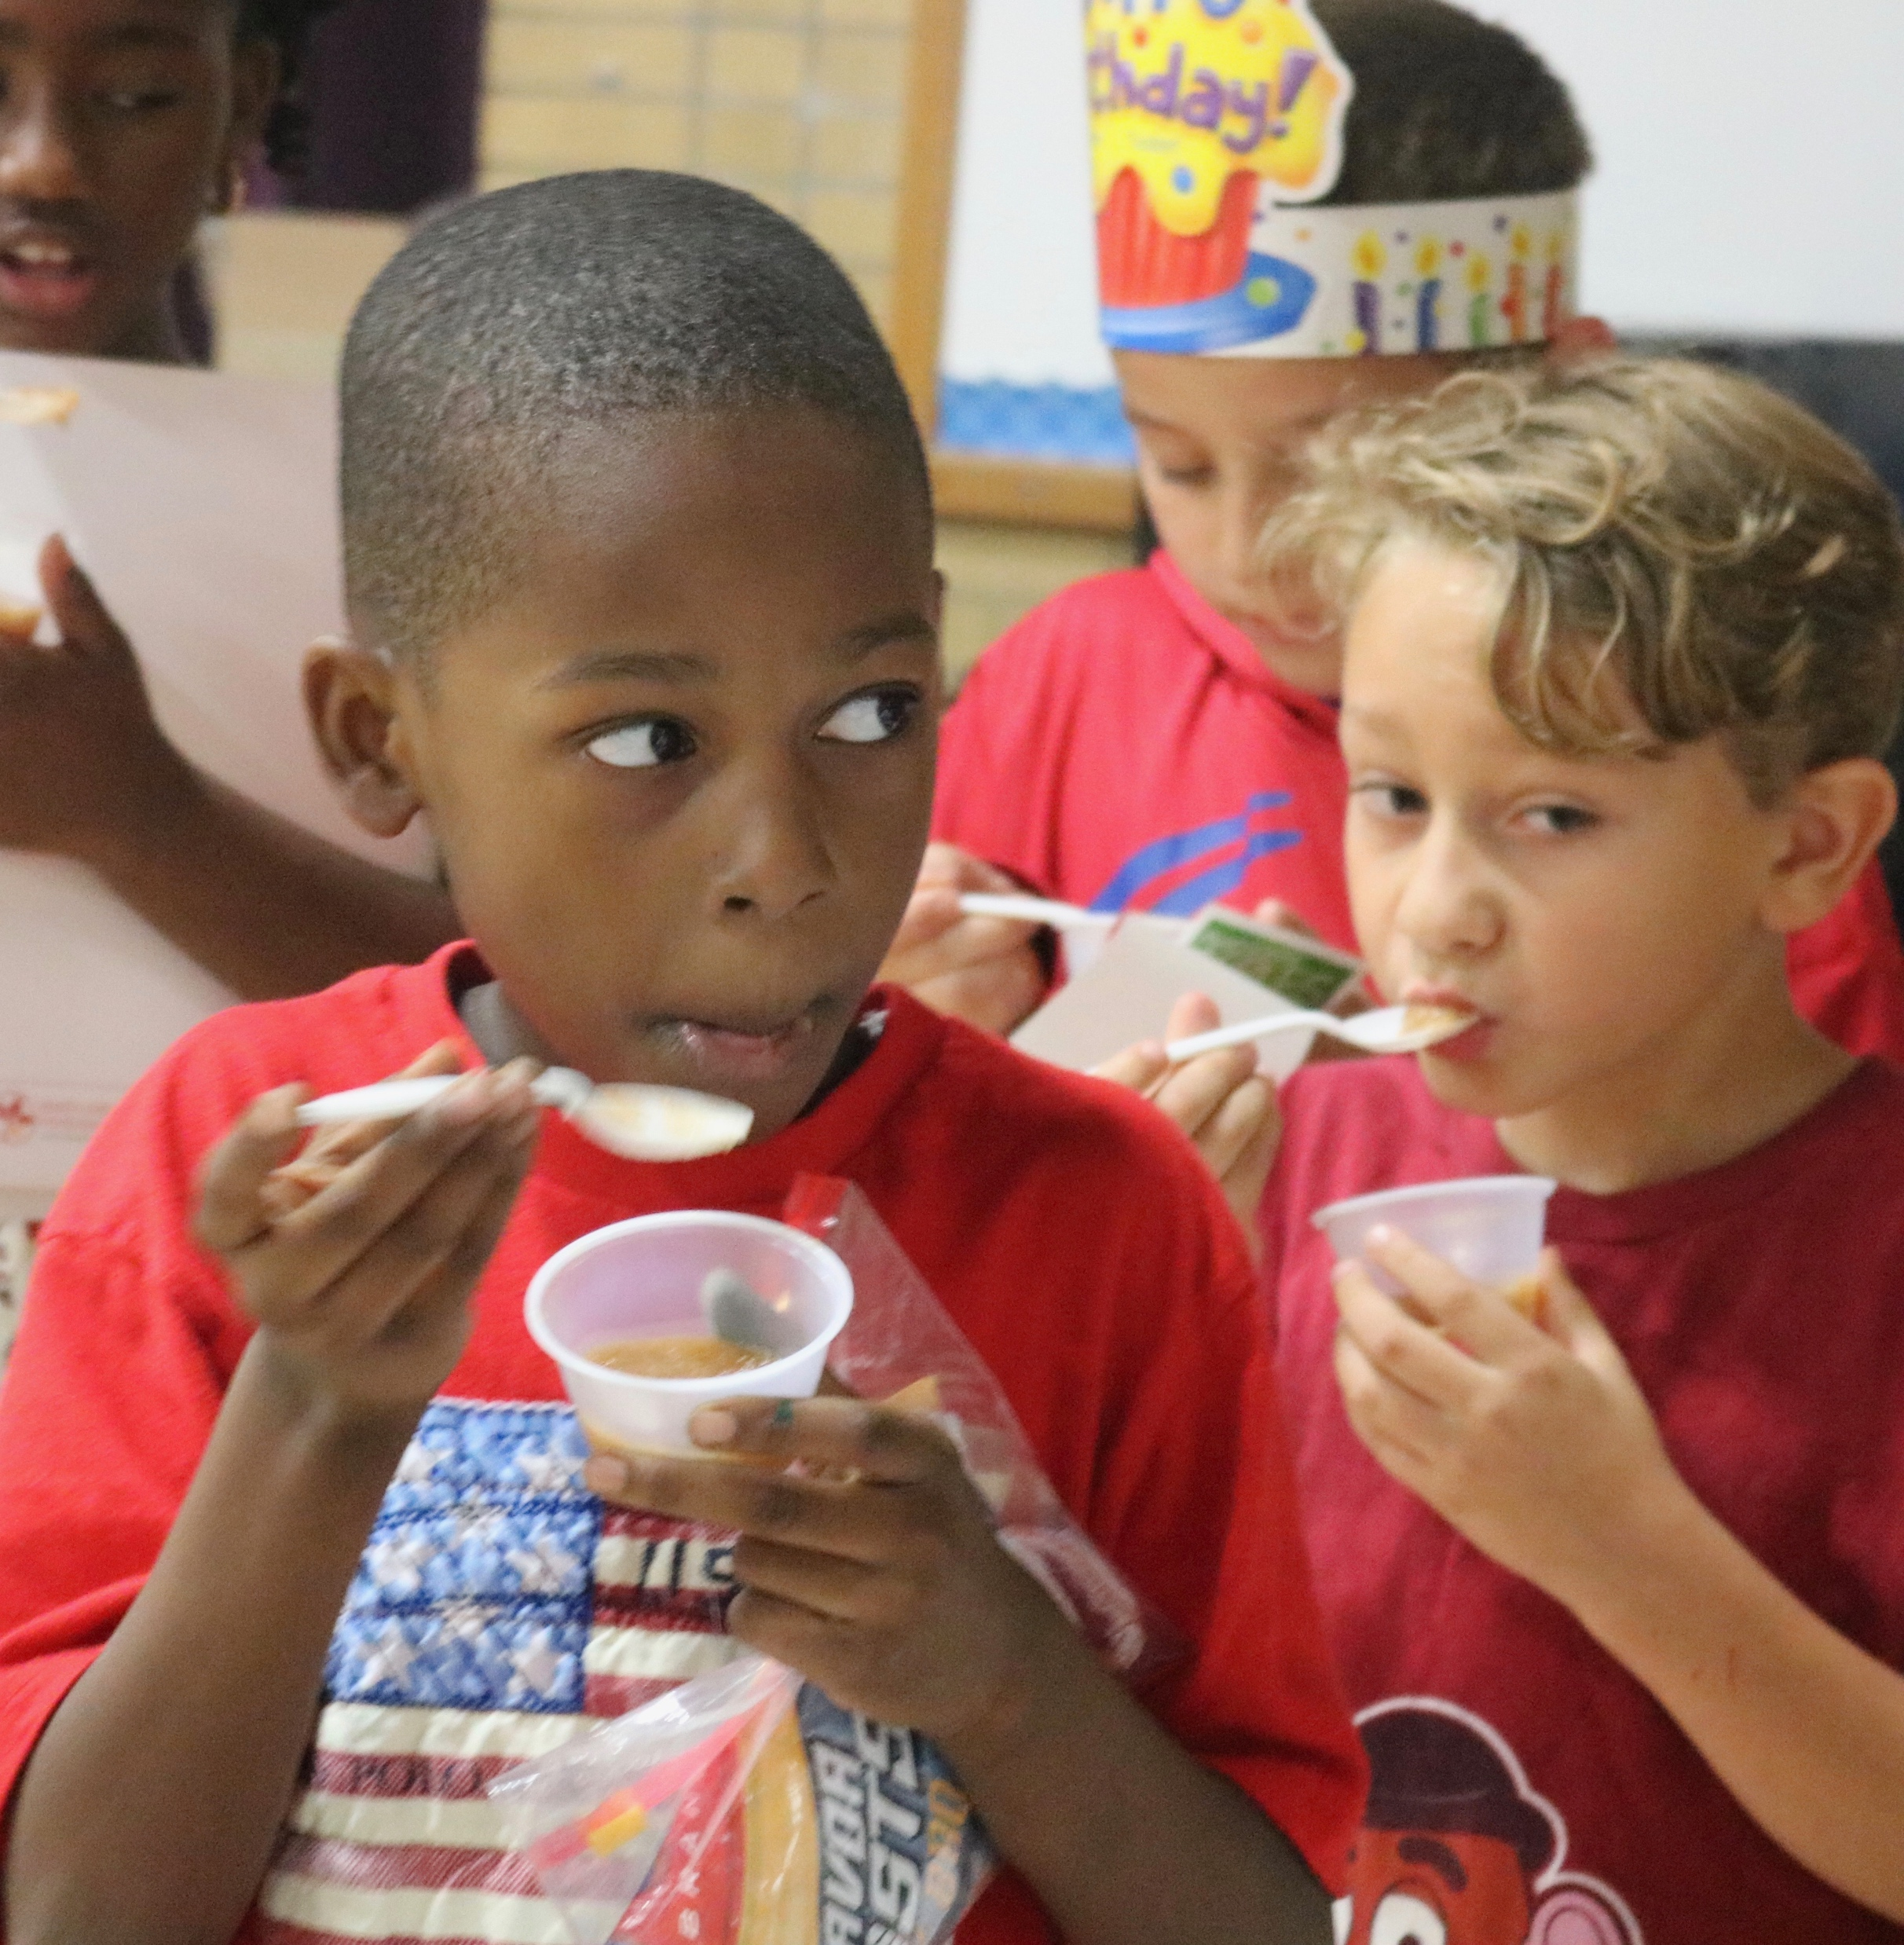
Snapshot
Nine cafeterias with service to Judy Center & Family Support Center
56% FARMS
5,500 students
Over 2,000 Direct Cert
Over 60 employees
Internal Catering service
All schools have breakfast in the classroom

Slide 6
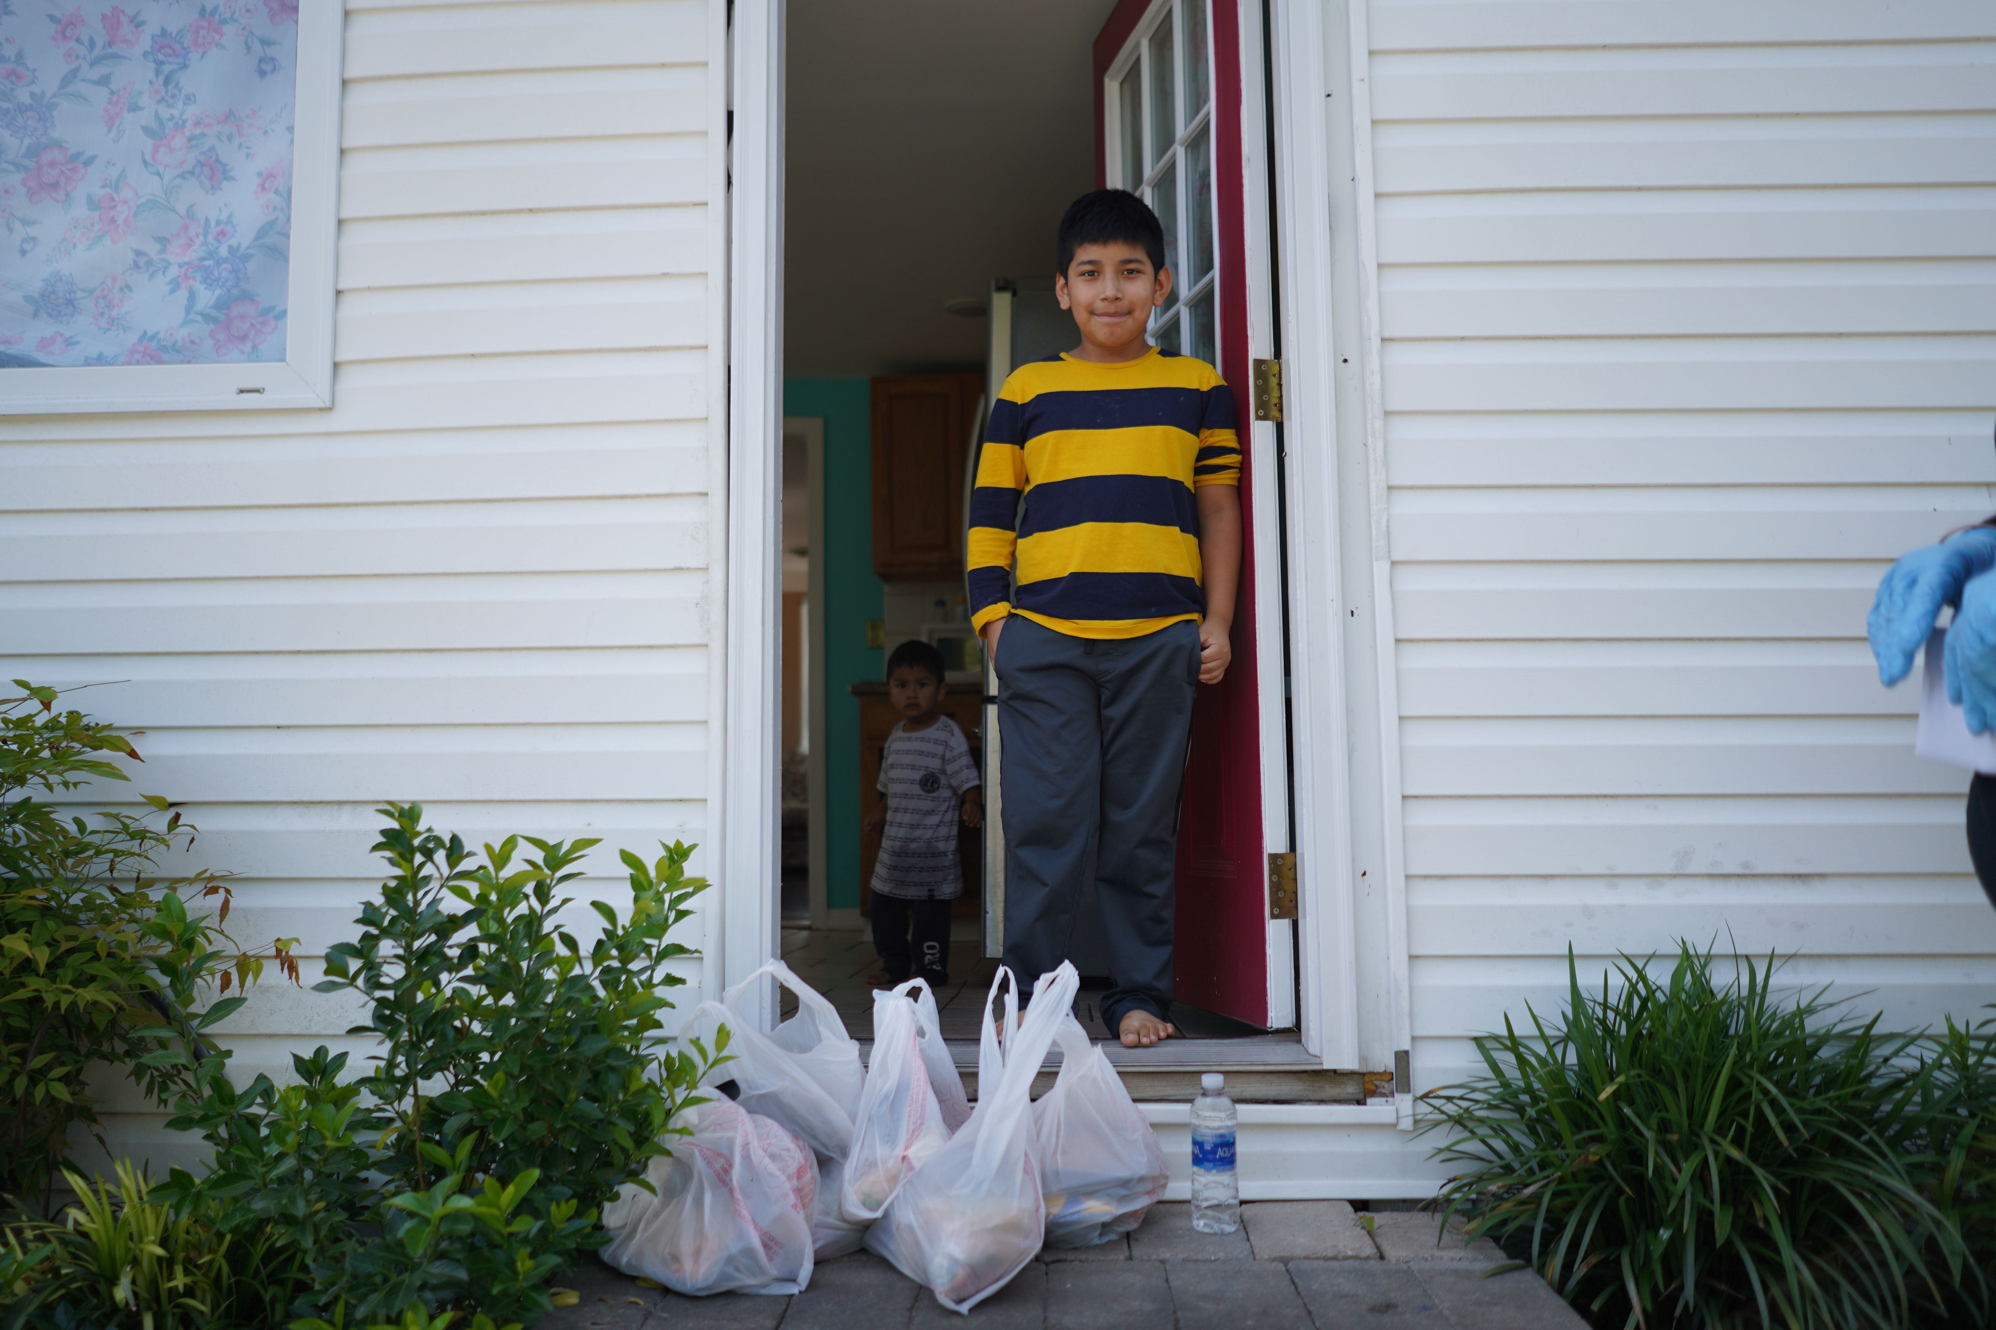
Average
Participation
Breakfast
Lunch
After School Meals
Summer Meals
3,800 daily
3,600 daily
46,500
18,500

Slide 7
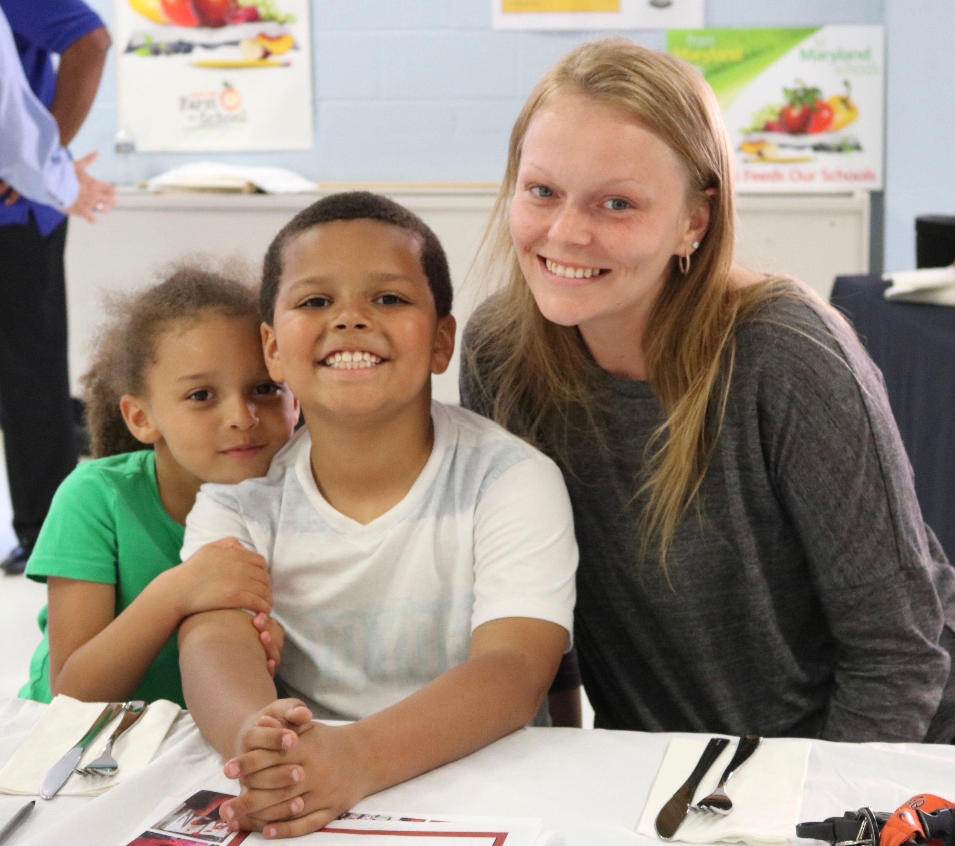
Our Mission
To create healthy, economically stable families through
  food equity
  job training
  youth prevention
  economic development
  education

Slide 9
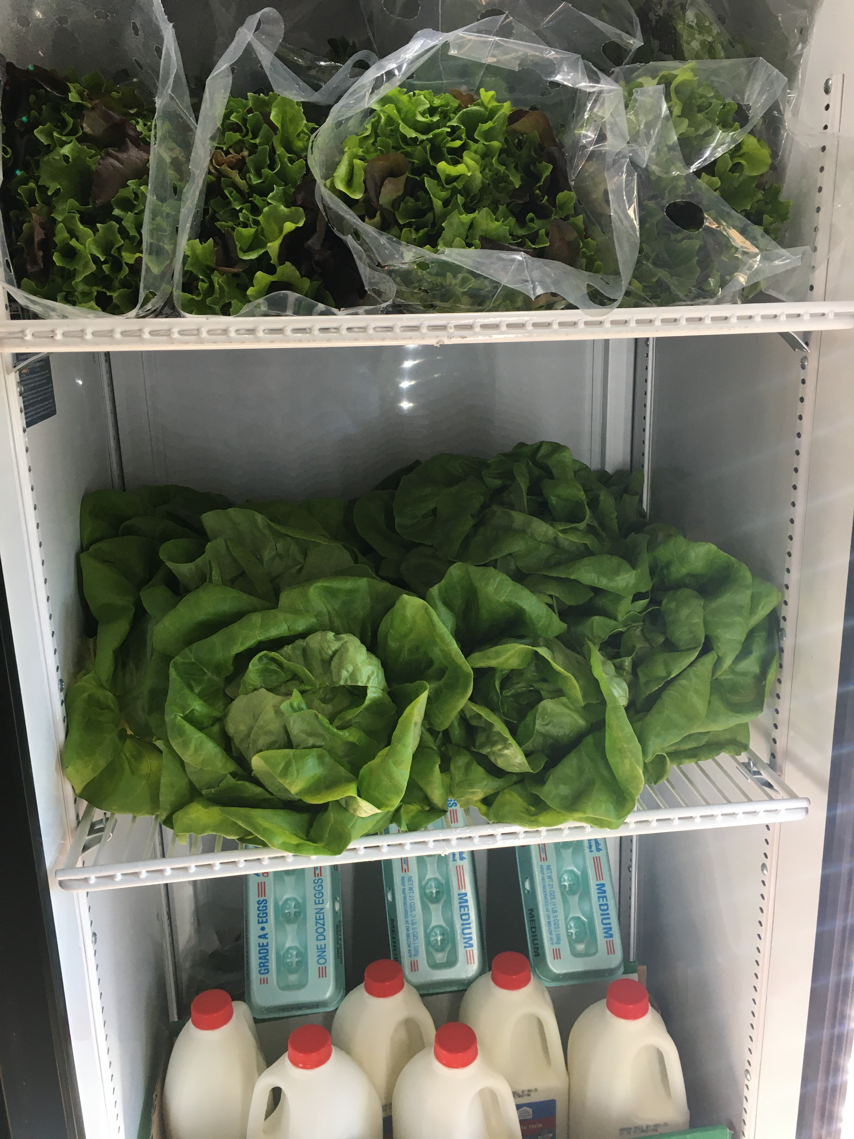
Feeding our Community
Building food resiliency
Mobile Farmers Market and food pantry service
Central backpack location
  Currently 709 a week
Summer Meals 18,000, After school 45,000
Frozen one tray meals for our highest risk students
Inexpensive one sheet meals for families

Slide 10
Why a Mobile Market?
Promotion of local farmers
SNAP accepted
Senior Citizen vouchers
Local economic development
Connect with your community
Food equity and security
Food desert areas
Rural setting limited public transportation

Slide 11
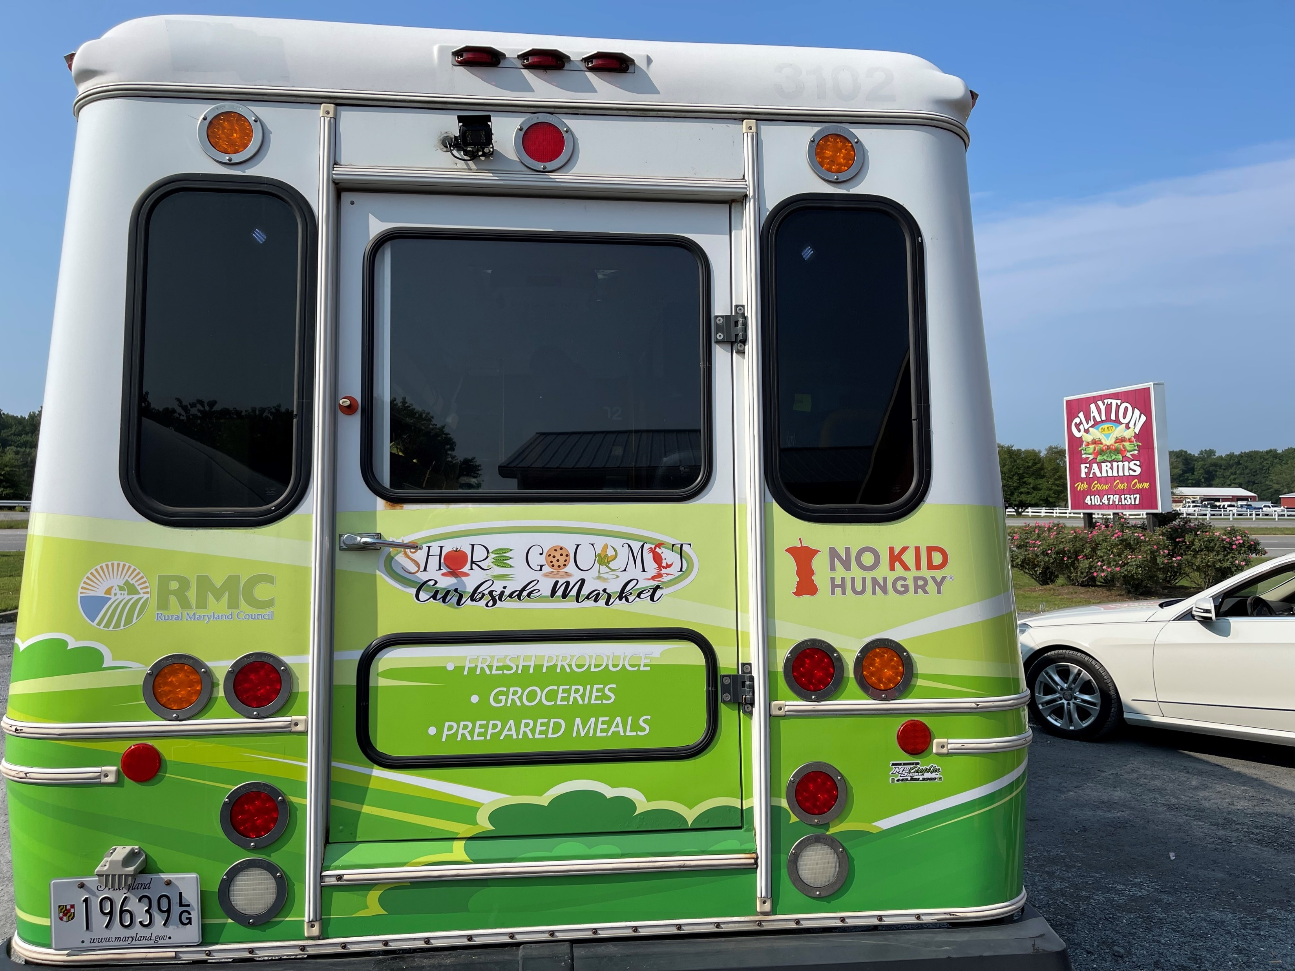
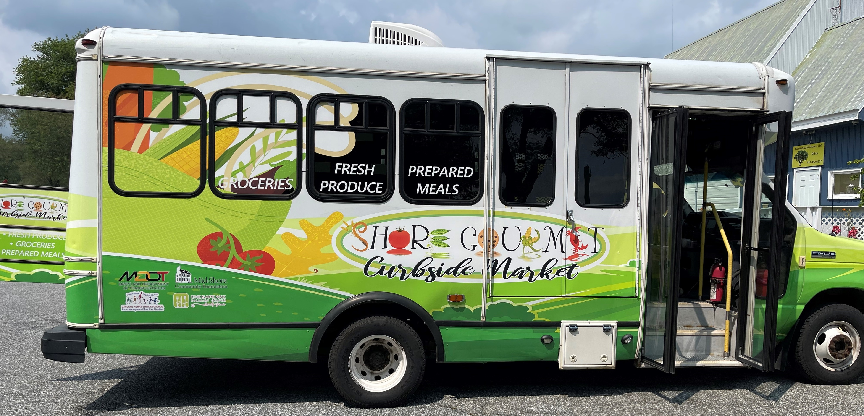
The Vehicle
MDOT – requested retired bus
  14 passenger bus (no CDL required), removable shelving unit
Rural MD council
  $20k to retrofit the bus: Wrap- $4k, $16k to gut the inside, run the electric, HVAC, build shelving, fabricate the walls

Slide 12
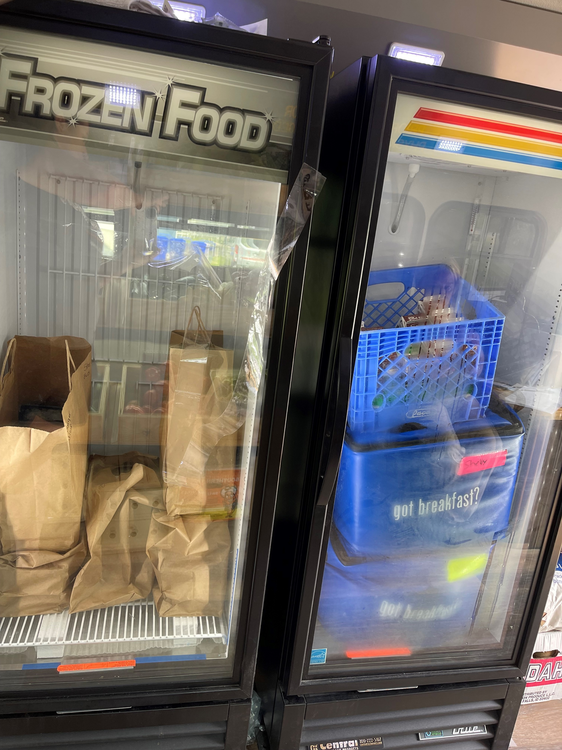
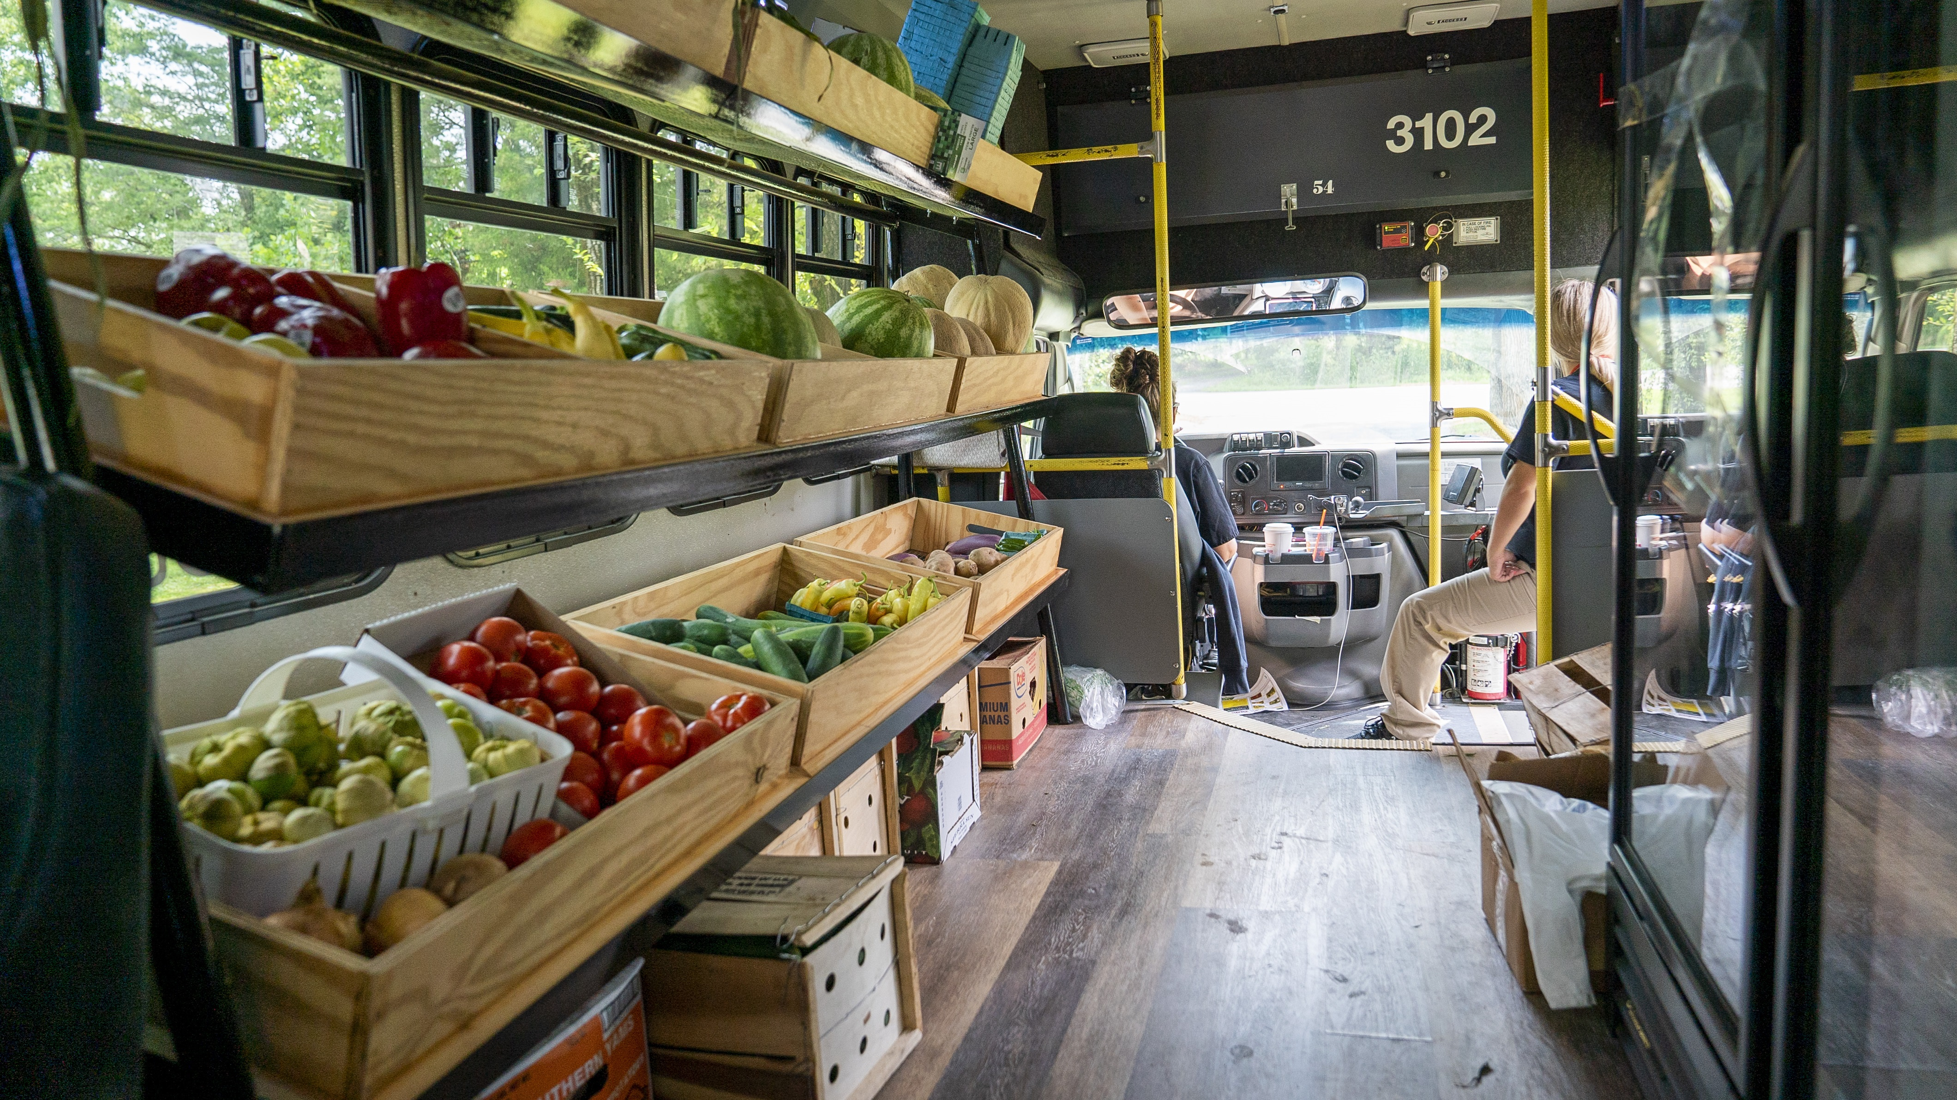
The Vehicle
Caroline Human Services Council (local government board)
  $12k grant- fridge & freezer, generator, handwashing station, signage
No Kid Hungry MD
  $50k grant- operations: staffing, r&m, gas,
  A-frame for signage

Slide 13
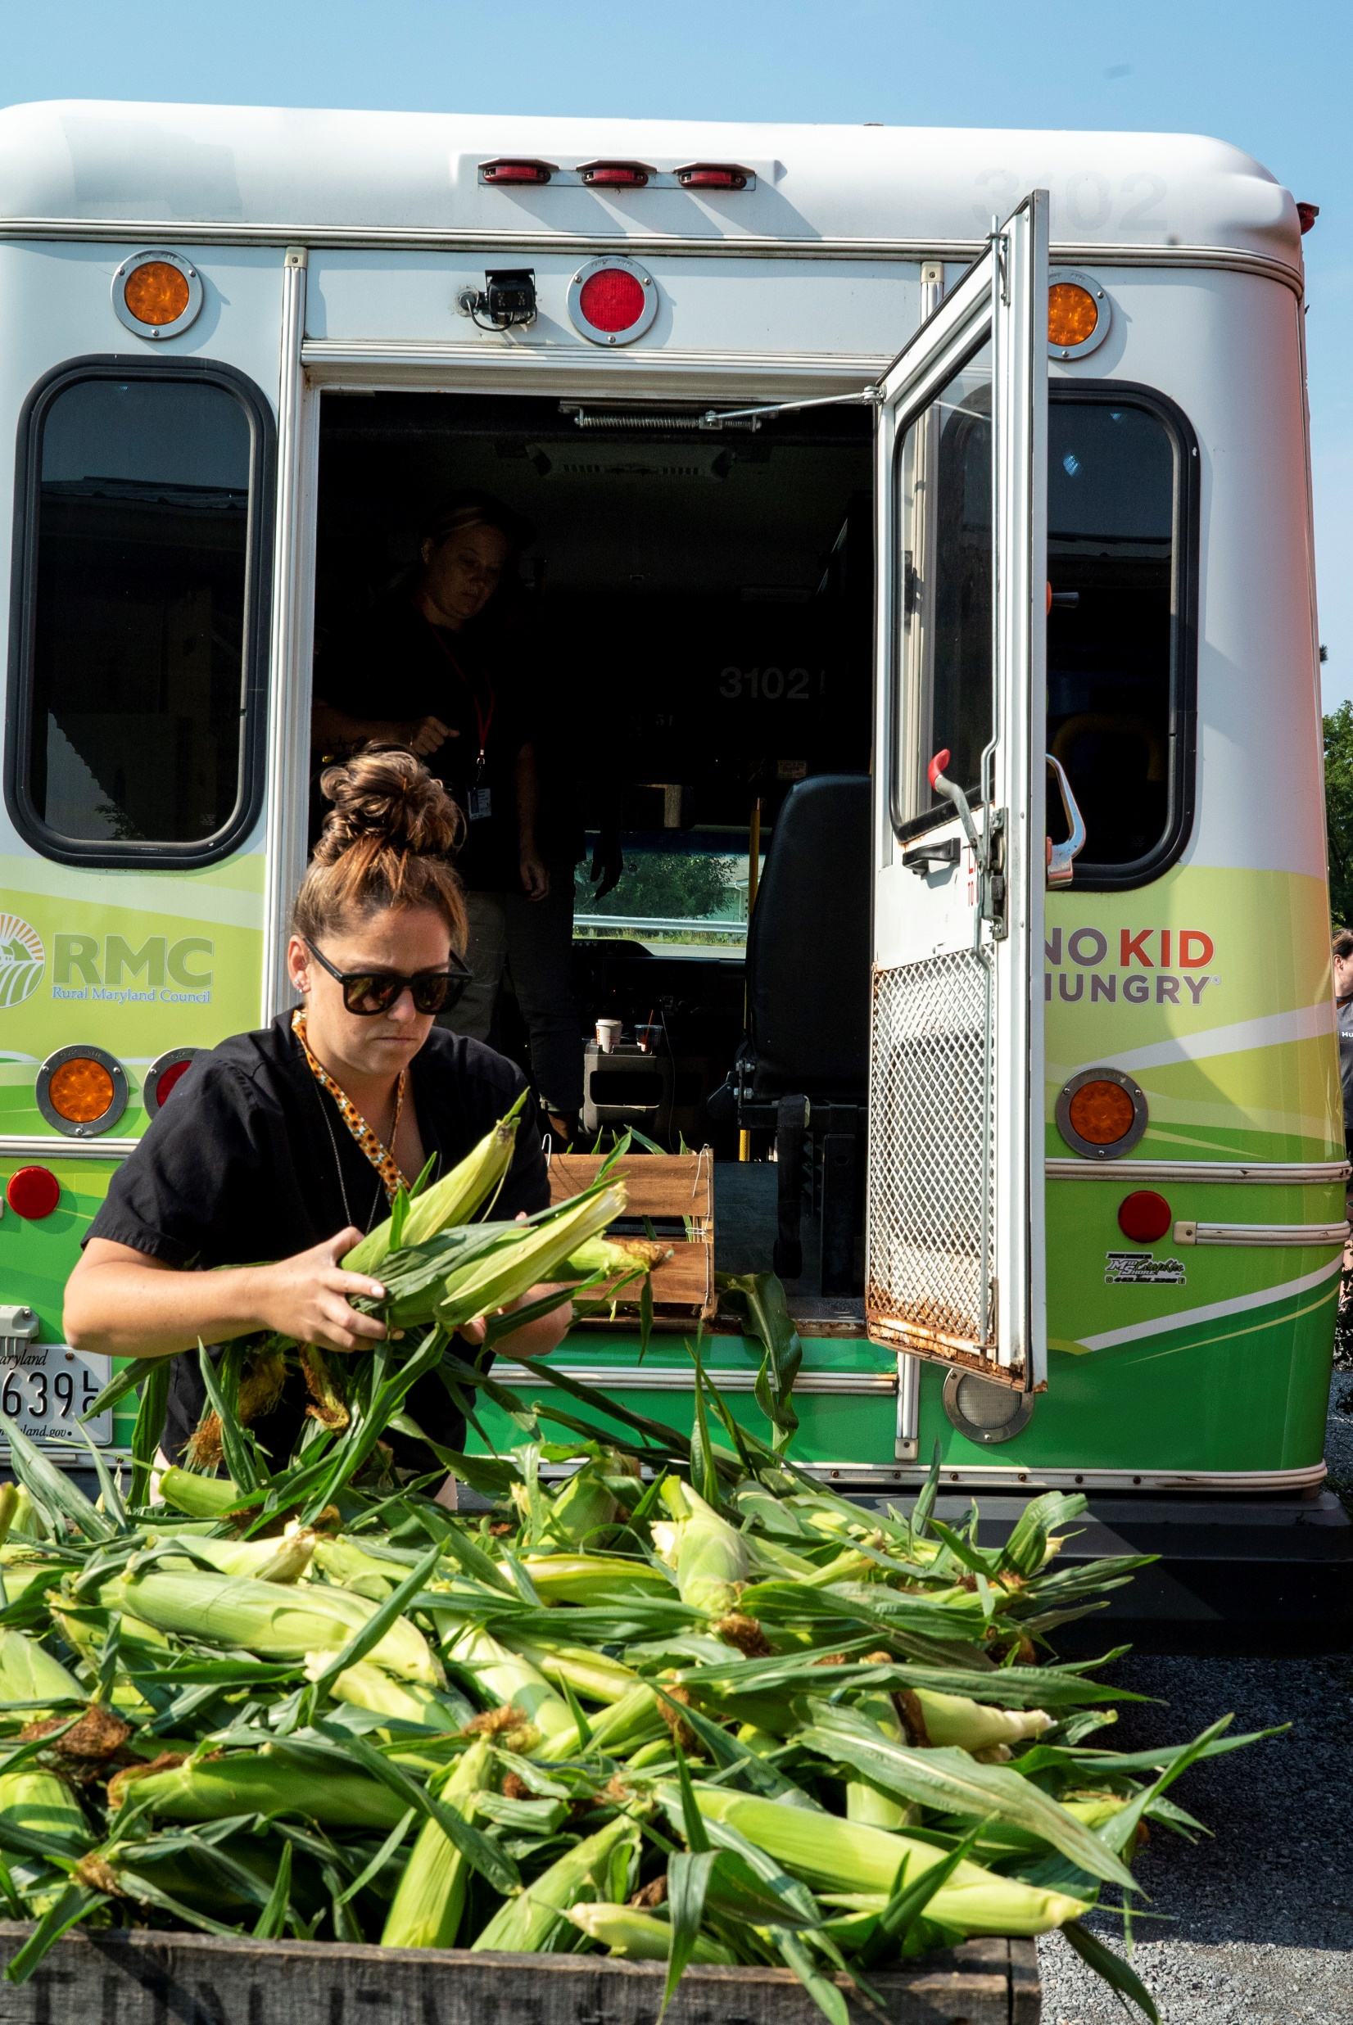
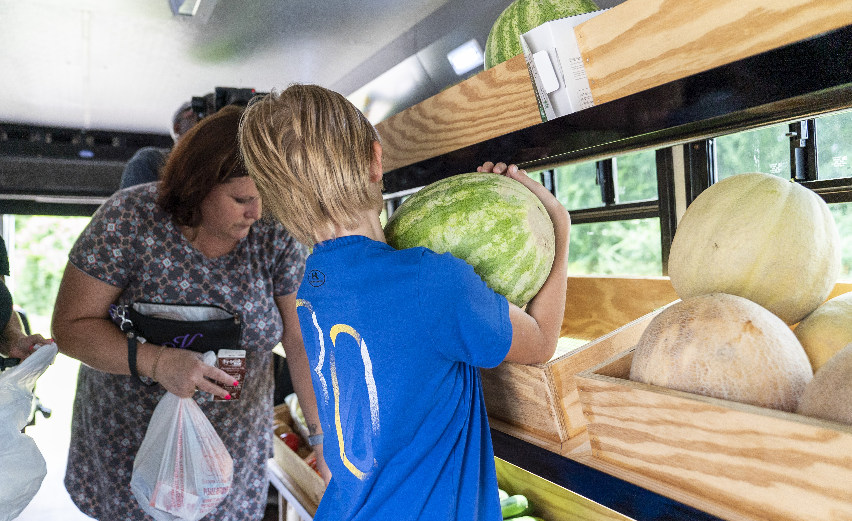
Products
Frozen one person meals in heat-able trays & soups
Fresh Produce (local if possible-Walmart)
  fruits and veggies
  soon local frozen produce
Staples-eggs, milk, bread, butter
Summer & Afterschool Meals
  Both cold & heat-able meals

Slide 14
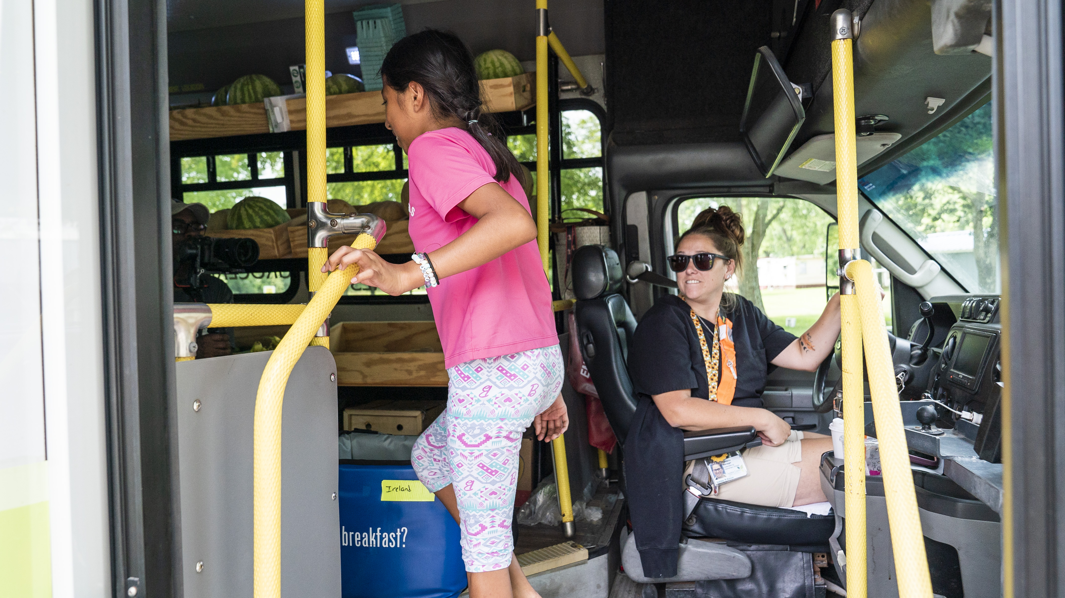
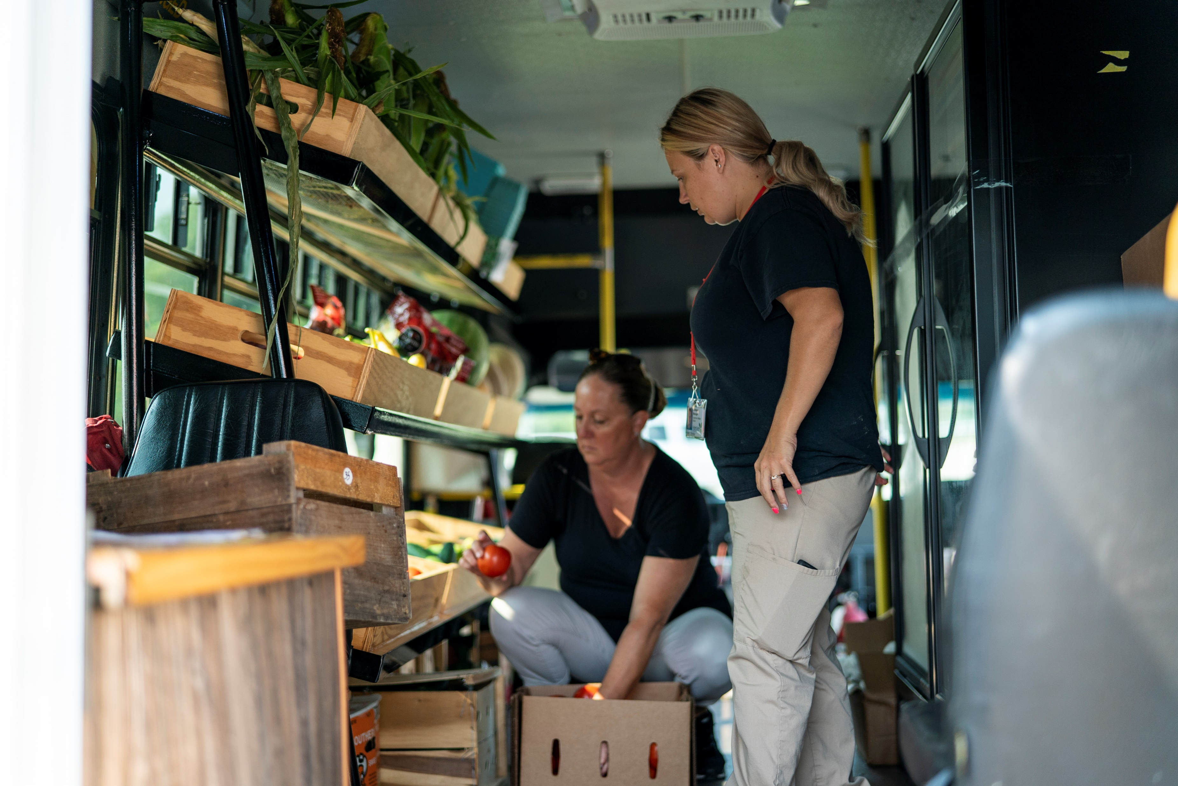
Staffing
Created a full time position
Farm to School Manager
  Connection with farmers
  Places orders
  Tower Garden Care
  F2S programming
  Stocks and rides the bus
  Fills in at schools when needed
Part Time/ Retiree to drive bus
18 hrs week

Slide 15
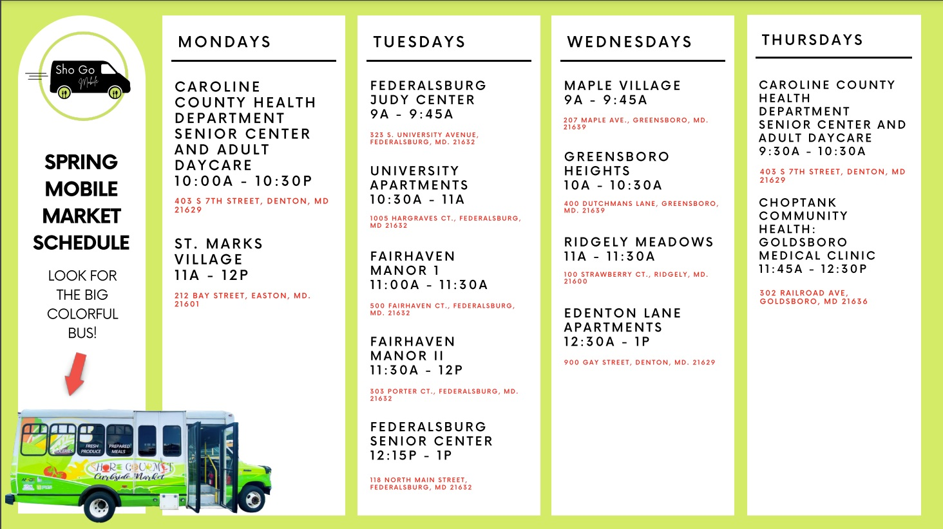
Planning a Route
Stopping at busy bus stops in high needs areas for supper meals & weekend back packs
Trial and error, flexibility
Reach out to subsidized housing co. & community centers
Churches
Existing food pantries
Homeless shelters
Health Departments & clinics

Slide 16
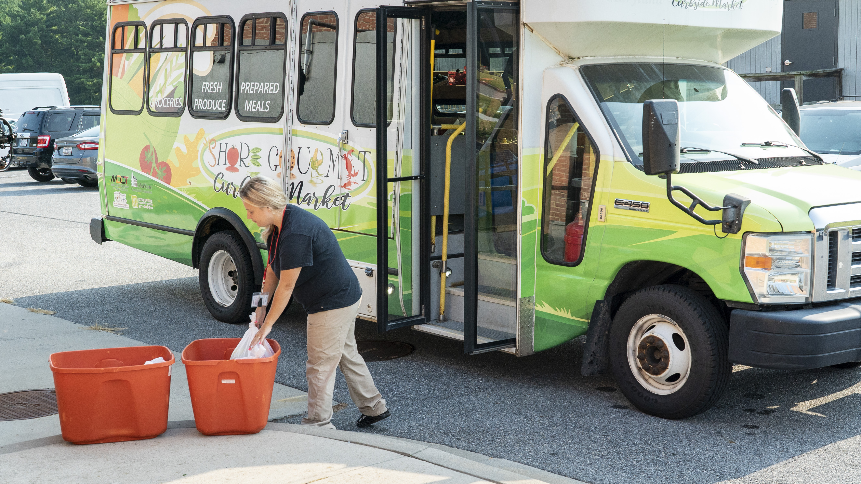
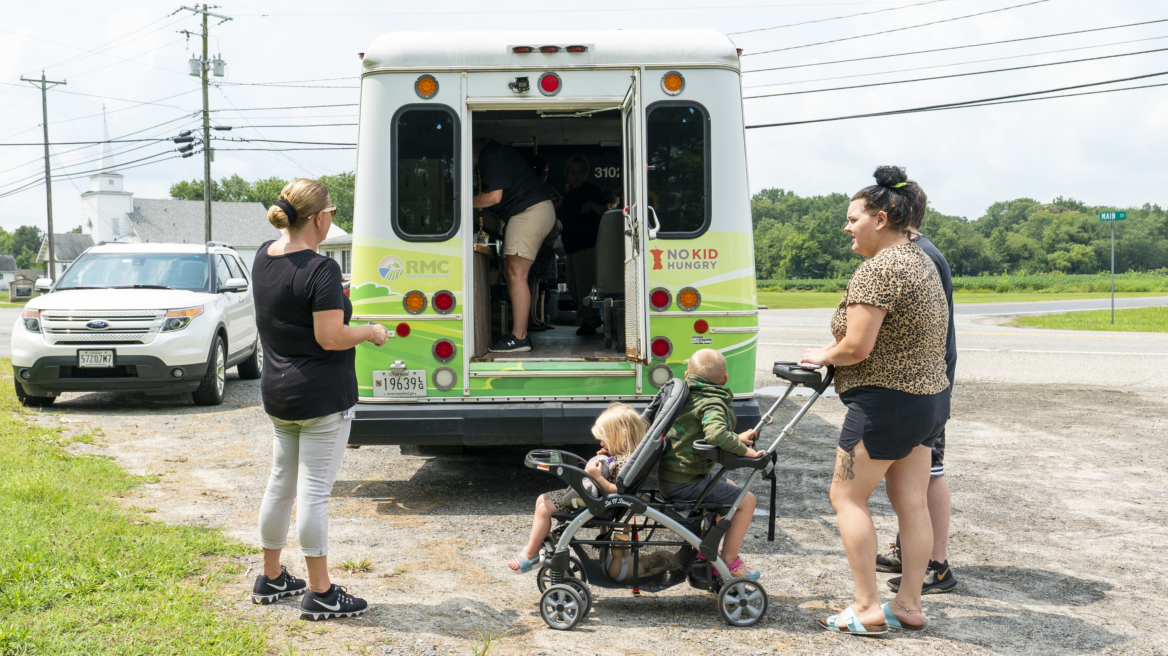
Challenges
COVID- bus, labor
SNAP with Board of Ed
Retrofit- length of time
Naming the bus
Mapping of neighborhoods
Long term sustainability
Community buy-in
Notes:
COVID- bus, labor
Getting through the SNAP; board of ed did not fit into their categories
the retrofit length of time, some due to covid some due to me not being able to stay on top of them. They took liberties that were not in the plan. One person that is a watch dog.
Coming up with a name. Geez this was hard. Decided to connect it with our Shore gourmet market for continuity.
figuring out the mapping of neighborhoods for the unit. Constant change of what works and what does not work.

Slide 17
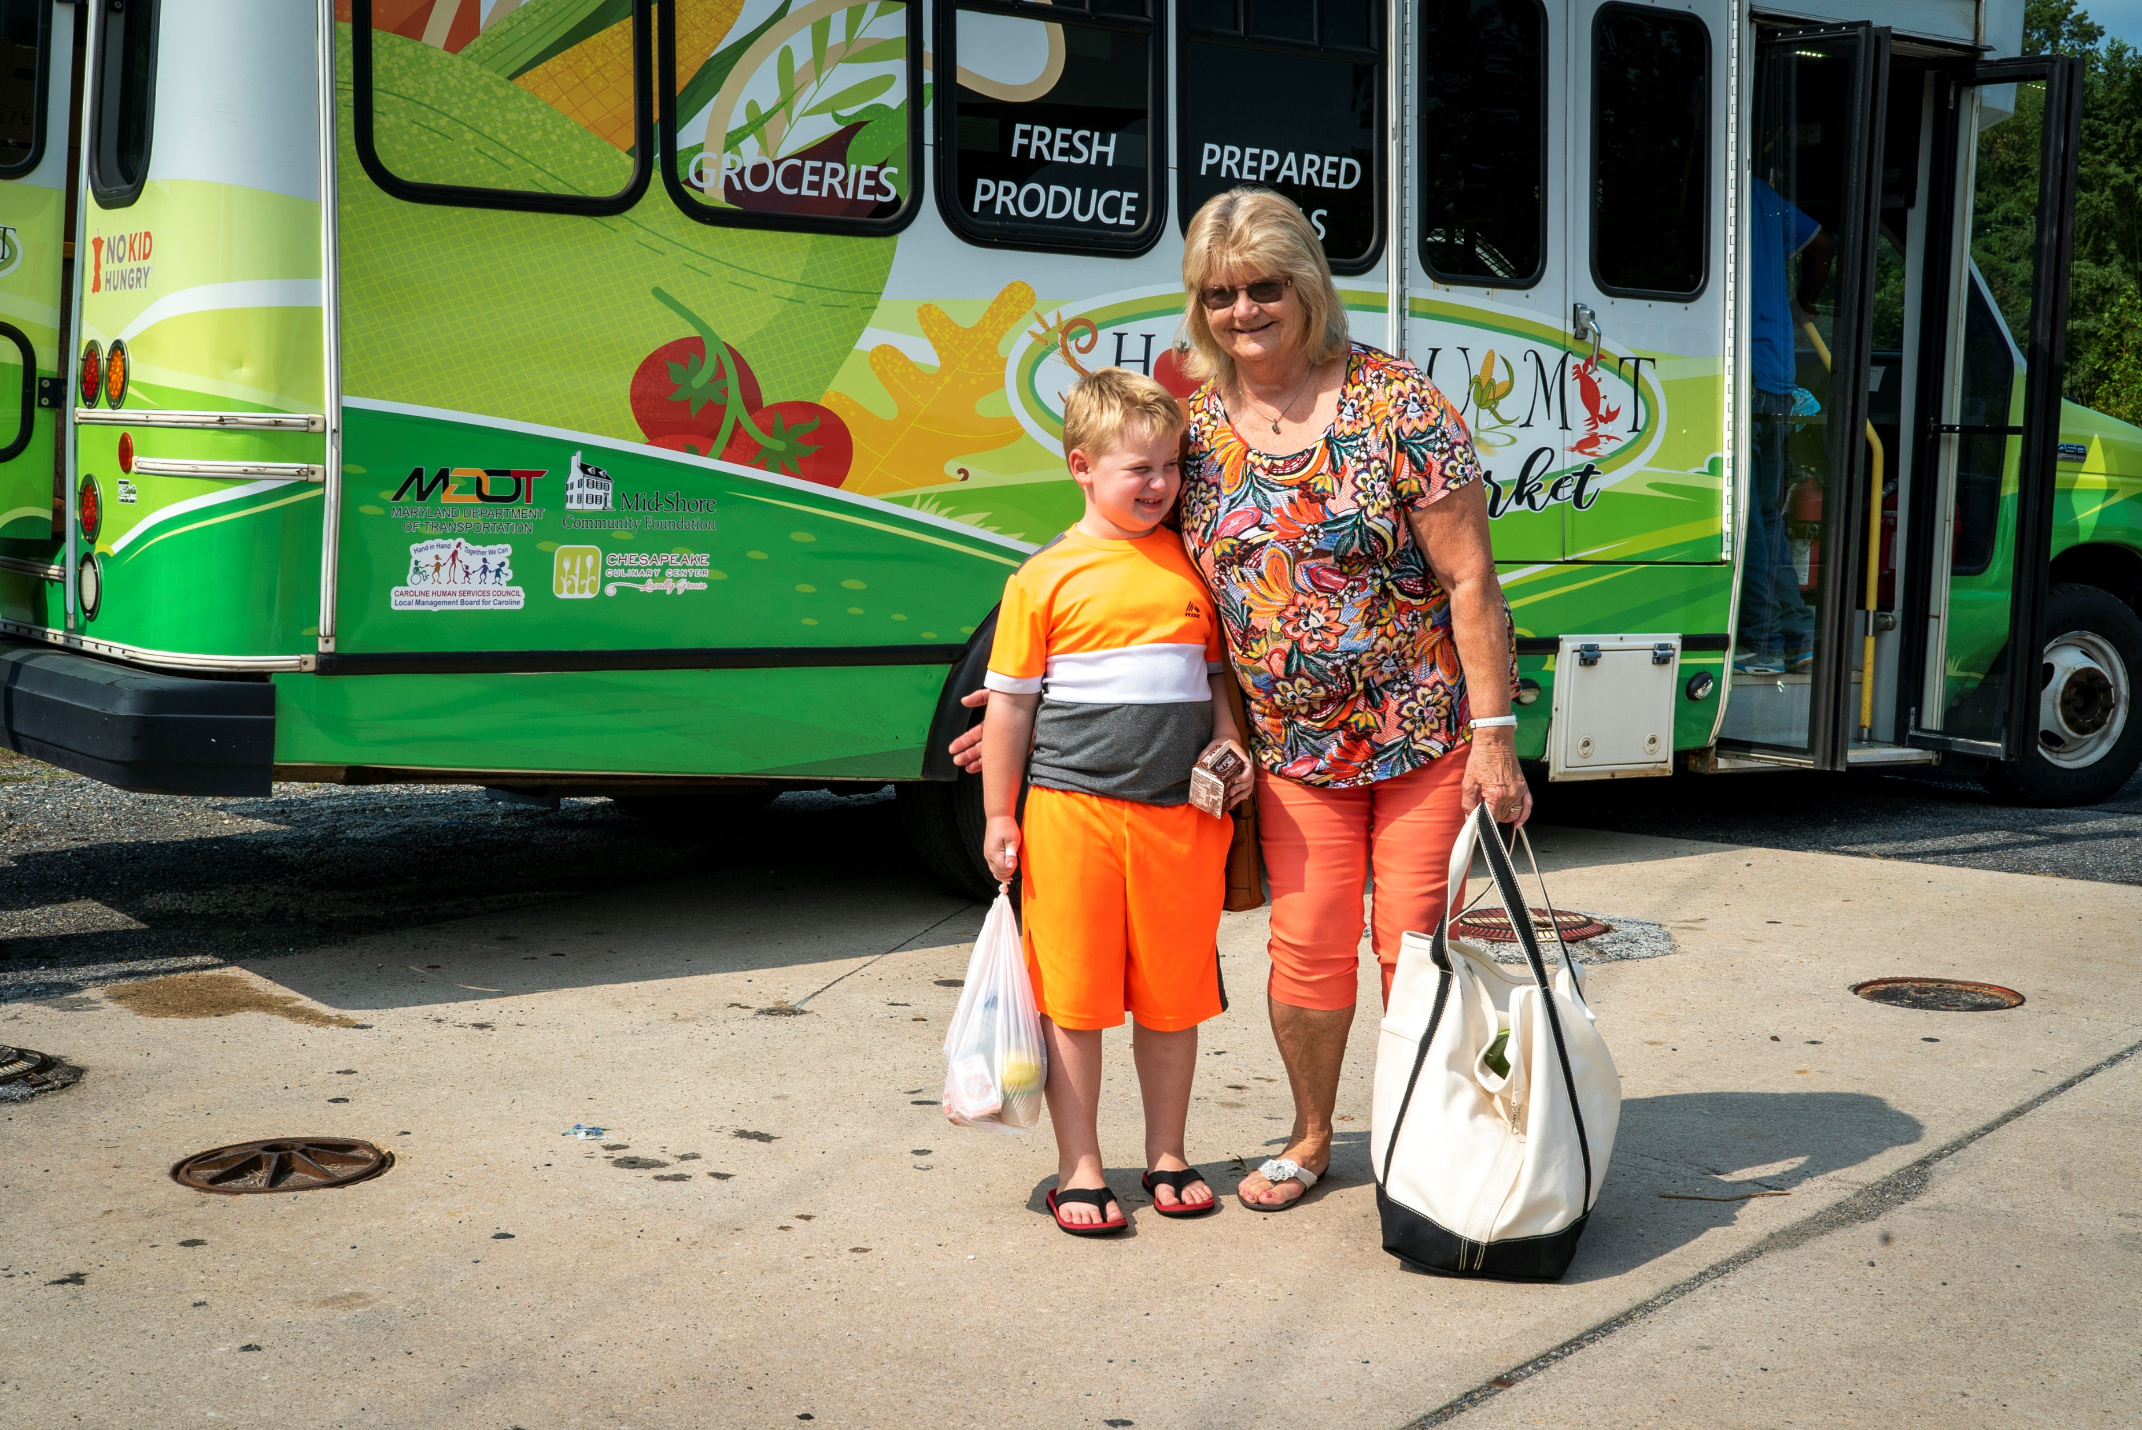
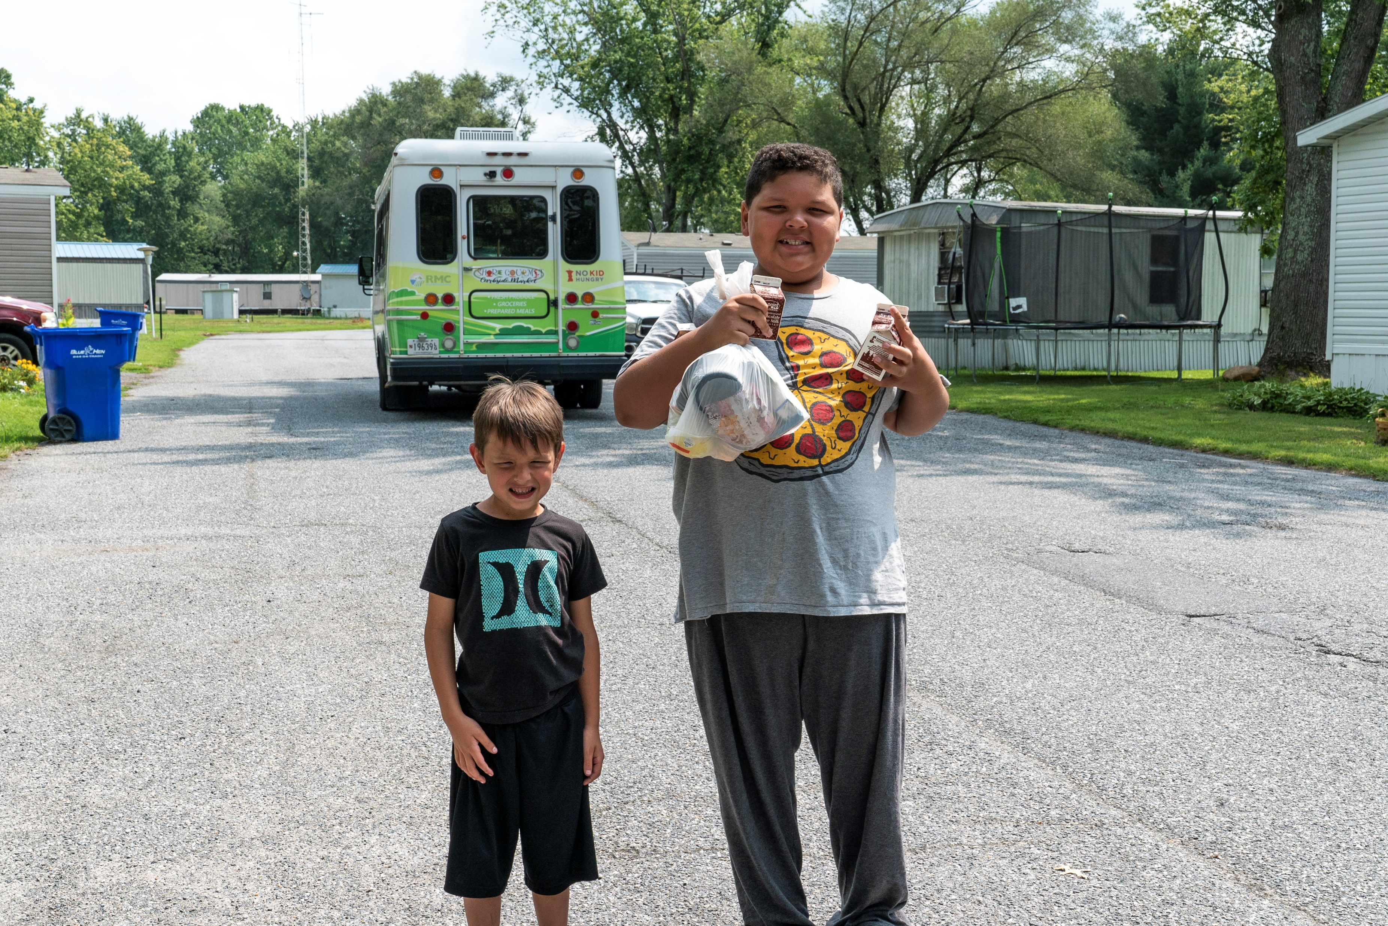
Sustainability &
Looking Forward
SNAP acceptance
Selling items
USDA Summer and afterschool meals
Grants
Private funders
Fundraisers

Slide 18
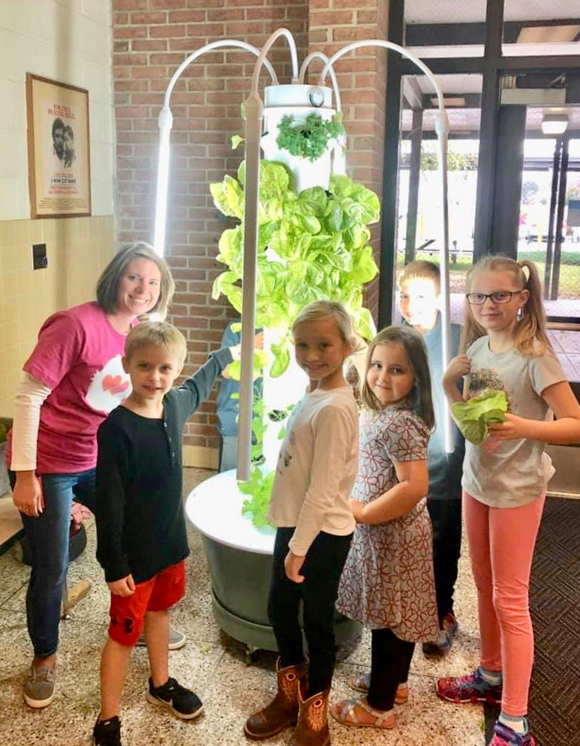
Connecting the Farm to School & Life
Aeroponic growing tower
All elementary & middle
Schools, library, Judy centers
Business yearly sponsorships
Nutrition and science learning
Intro to culinary & ag education

Slide 19
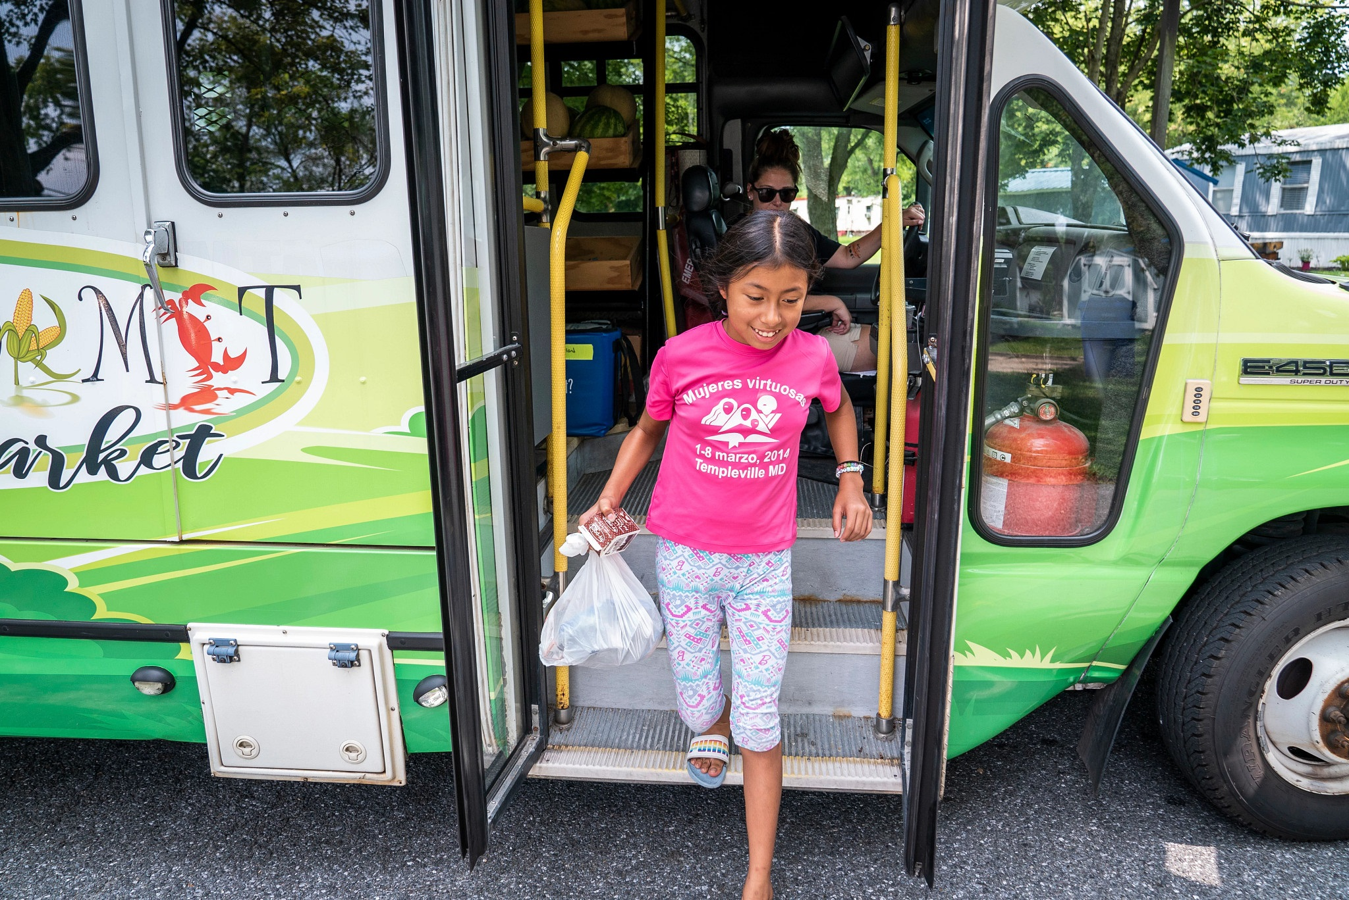
Partnerships
Library for free books
Choptank Health mobile unit for wellness checks and "food is medicine" scripts for produce
Local farmers (stands) for summer harvest & Walmart during the winter months
University of MD extension for recipe cards, labeling, and educational materials

Slide 20
Grant Sources/ Partners
Food Insecurity
Caroline County Public Schools
Caroline Human Services Council
Food for Learning
Caroline Foundation
Caroline Helping Hands
Mid Shore Community Foundation
Farmers / Local
Mid Shore Regional Council
Rural Maryland Council
Maryland Department of AG

Slide 21
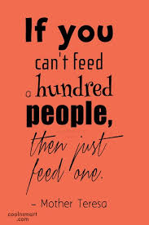
Questions?
Beth Brewster- brewster.amanda@ccpsstaff.org
Kara Panowitz- kpanowitz@strength.org

Slide 22
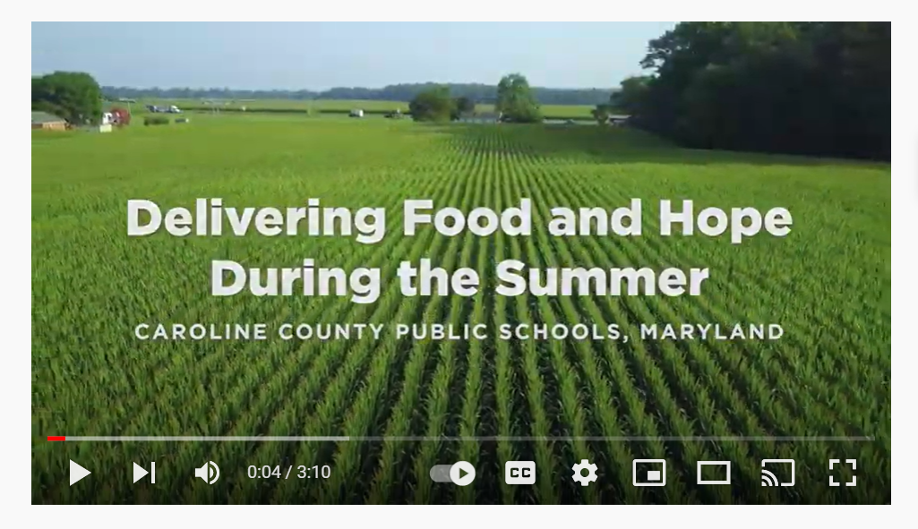
https://youtu.be/-UtSHa_8lqQ

